Slide 1
Network
Security

Slide 2
Network security
Foundations:
what is security?
cryptography
authentication
message integrity
key distribution and certification
Security in practice:
application layer: secure e-mail
transport layer: SSL
network layer: IP security

Slide 3
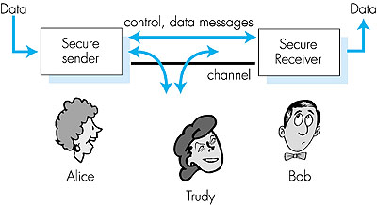
Network Security
Network Entities: Friends and Enemies
Insecure medium
well-known in network security world
Bob, Alice want to communicate 'securely'
Trudy, the intruder may intercept, delete, add messages
Routers – exchange tables
Email applications – exchange secure emails
Client-server – establish secure transport connection

Slide 4
What is network security?
DESIRABLE PROPERTIES OF SECURE CONNECTION
1
Secrecy: only sender, intended receiver should understand message contents
sender encrypts messages
receiver decrypts messages
Authentication: sender, receiver want to confirm identity of each other
Message Integrity: sender, receiver want to be sure message did not get altered (in transit), or get altered without detection
2
3

Slide 5
What is network security?
DESIRABLE PROPERTIES OF SECURE CONNECTION
4
Operational Security:
communication can occur in the first place
Prevent Denial-of-Service attacks (DoS)
ensures network entities can gain access to resources if they have access rights and perform accesses in a well-defined manner
Firewall – controls packet access to and from the network by regulating which packet can pass into and out of the network

Slide 6
Network Security
CYCLE IN ACHIEVING NETWORK SECURITY
1
Protect: network communication and network resources
Detect: breaches of secure communication & attacks on infrastructure
Respond: deployment of additional protection mechanisms
2
3

Slide 7
Some interesting news (23 Sept 2016)
Yahoo confirms 'state-sponsored' hackers stole personal data from 500m accounts
The company has confirmed that the breach took place in 2014 but its statement left pressing questions unanswered.
why disclosure took so long, both from the date of the hack, almost two years ago, and from the first appearance of the dumped data on the dark web almost two months ago where it was being sold by a user named “Peace of Mind”, who had also sold dumps of data from MySpace (359M) and LinkedIn (164M).
we don’t have any indication as to when Yahoo first learned about this breach (includes swathes of personal info, including names, emails, phone numbers, dates of birth, encrypted passwords, “unencrypted security questions and answers”, but not credit card data.

Slide 8
Yahoo confirms 'state-sponsored' hackers stole personal data from 500m accounts
“State-sponsored adversaries don’t typically publicly share stolen data or sell it, like profiteer hacker ‘Peace of Mind’. Peace of Mind was all about selling stolen Yahoo account data, so it’s unlikely he was state-sponsored. And if so, this means it’s possible we’re looking at two different Yahoo breaches with two different hacking groups in their system.” - Grossman
Equally unclear is the extent to which passwords were protected. Yahoo has confirmed the passwords were hashed, a one-way transformation which allows the site to check that an entered password is correct without needing to store the actual password.
The breach also highlights a strong problem with “security questions”, the common practice of letting users reset passwords by answering questions about their first house or mother’s maiden name. Yahoo did not encrypt all the security questions it stored, and so some are readable in plaintext. While it may be irritating to have to change a stolen password, it is somewhat worse to have to change a stolen mother’s maiden name.

Slide 9
Yahoo confirms 'state-sponsored' hackers stole personal data from 500m accounts
Advice for Yahoo email users
Users need to change their Yahoo password and security questions (better yet, disable this feature!) as soon as possible, and also change the password anywhere else they may have re-used that information. Ideally, they should stop re-using passwords altogether.
Since Yahoo is a major webmail provider, there’s one extra problem: any further service which has password reset emails sent to a Yahoo Mail account should also be considered compromised, and passwords accordingly changed.
Source: https://www.theguardian.com/technology/2016/sep/23/yahoo-questinos-hack-researchers

Slide 10
Cryptography

Slide 11
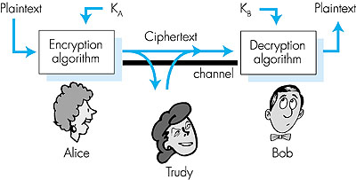
The language of cryptography
plaintext
K
K
plaintext
A
B
ciphertext
Figure 7.3 goes here
symmetric key crypto: sender, receiver keys are identical
public-key crypto: encrypt key public, decrypt key secret

Slide 12
Cryptography
Symmetric Key

Slide 13
Cryptography
From Alice to Bob: (SENDER)
Key: K_{A}
Plaintext Message: m
Encryption
Algorithm
Ciphertext: K_{A}(m)
Bob’s side: (RECEIVER)
Encrypted Message: K_{A}
key: K_{B}
Decryption
Algorithm
Plaintext: m
K_{B}(K_{A}(m))
Symmetric key systems: K_{A}=K_{B}, kept secret
Public key systems: 1 key: known to the world
other key: known only by Alice or Bob (but not both)

Slide 14
Symmetric Key
substitution cipher: substituting one thing for another
Ceasar cipher: pick a letter in the plain text, then substitute it with another letter that is k letters later (allowing wrap around).
plaintext: abcdefghijklmnopqrstuvwxyz
k=3
ciphertext: defghijklmnopqrstuvwxyzabc
e.g.:
Plaintext: bob, i love you. alice
ciphertext: ere, l oryh brx. dolfh
25 possible key values
Encryption key: mapping from set of 26 letters to set of 26 letters

Slide 15
Symmetric Key
substitution cipher: substituting one thing for another
Monoalphabetic cipher: substitute one letter for another
plaintext: abcdefghijklmnopqrstuvwxyz
ciphertext: mnbvcxzasdfghjklpoiuytrewq
e.g.:
Plaintext: bob. i love you. alice
ciphertext: nkn. s gktc wky. mgsbc
26! (in the order 10^26) possible pairings of values
Encryption key: mapping from set of 26 letters to set of 26 letters

Slide 16
Symmetric Key
substitution cipher: substituting one thing for another
Polyalphabetic cipher: apply multiple monoalphabetic ciphers, according to some cycling pattern
n substitution ciphers, M₁,M₂,…,M_{n}
cyclic pattern:
e.g., n=4: M₁,M₃,M₄,M₃,M₂; M₁,M₃,M₄,M₃,M₂; ..
for each new plaintext symbol, use subsequent substitution pattern in a cyclic pattern
bob: b apply M₁, o apply M₃, b apply M₄
Encryption key: n substitution ciphers, and cyclic pattern

Slide 17
Symmetric Key
Example
Polyalphabetic cipher: apply multiple monoalphabetic ciphers, according to some cycling pattern
Example
n substitution ciphers: 2 Ceasar ciphers(k=5, k=19)
cyclic pattern: C₁,C₂,C₂,C₁,C₂
plaintext: abcdefghijklmnopqrstuvwxyz
k=5
ciphertext: fghijklmnopqrstuvwxyzabcde
plaintext: abcdefghijklmnopqrstuvwxyz
k=19
ciphertext: tuvwxyzabcdefghijklmnopqrs
e.g.:
Plaintext: bob, i love you.
ciphertext: ghu, n etox dhz.

Slide 18
Cryptography
Symmetric Key
Block Cipher

Slide 19
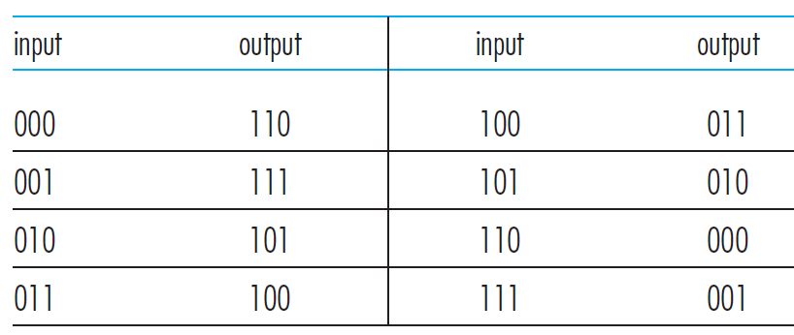
Symmetric Key
Block Cipher
Block cipher: the message is encrypted in blocks of k bits.
Example:
Block cipher is used in PGP (for secure e-mail), SSL (for securing TCP connections), and IPsec (for securing the
network-layer transport)
Original Message
010110001111
3-bit blocks
010 110 001 111
Encrypted form
101 000 111 001

Slide 20
Symmetric Key
Block Cipher
Block cipher: the message is encrypted in blocks of k bits.
Example:
In general, given k bits, there are (2^k)! possible mappings
k=64
Even for moderate values of k, (e.g. k=64), the number of possible mappings is already astronomical! – a robust scheme
k=3
2^3 = 8 possible inputs
However, to implement, maintaining a table with (2^64) is an infeasible task
8! = 40,320 possible permutations
Brute force attack requires examining 40,320 possible mappings
Solution: use functions that simulate randomly permuted tables
Notes:
In this example, if the mapping table can be found (but it takes 8!), then the ciphertext can be decrypted.

Slide 21
Symmetric Key
Block Cipher
Block cipher: the message is encrypted in blocks of k bits.
Example:
Weakness
Identical plaintext blocks produce the same ciphertext blocks
k=3
Example:
Brute force attack requires examining 40,320 possible mappings
plaintext = 010 010 010
ciphertext = 101 101 101

Slide 22

Cryptography
Symmetric Key
Block Cipher $⊕$ random number
Avoid generating the same ciphertext for identical plaintext blocks

Slide 23
Symmetric Key
Avoid generating the same ciphertext for identical plaintext blocks
Block cipher + rand number: the message is encrypted in blocks of k bits XOR random number.
Let us consider the following definitions:
Example:
k=3
m(i) = ith plaintext block
c(i) = ith ciphertext block
a $⊕$ b = XOR of two bit strings
K_{s}= block-cipher encryption algorithm with key S.
plaintext = 010 010 010
m(1)
m(2)
m(3)

Slide 24
Symmetric Key
Avoid generating the same ciphertext for identical plaintext blocks
Block cipher + rand number: the message is encrypted in blocks of k bits XOR random number.
To encrypt: XOR, $\text{K}\text{s}\text{( )}$
Example:
k=3
m(i) = ith plaintext block
c(i) = ith ciphertext block
a $⊕$ b = XOR of two bit strings
K_{s}= block-cipher encryption algorithm with key S.
plaintext = 010 010 010
Step 1. Generate a random k-bit number r(i) for each block i.
m(1)
m(2)
m(3)
r(i) = random number to be used by ith ciphertext block
r(1)=001
r(2)=111
r(3)=100

Slide 25
Symmetric Key
Avoid generating the same ciphertext for identical plaintext blocks
Block cipher + rand number: the message is encrypted in blocks of k bits XOR random number.
To encrypt: XOR, $\text{K}\text{s}\text{( )}$
Example:
k=3
m(i) = ith plaintext block
c(i) = ith ciphertext block
a $⊕$ b = XOR of two bit strings
K_{s}= block-cipher encryption algorithm with key S.
plaintext = 010 010 010
Step 1. Generate a random k-bit number r(i) for each block i.
m(1)
m(2)
m(3)
r(i) = random number to be used by ith ciphertext block
Step 2. Calculate the ciphertext for each block i.
r(1)=001
c(i) = K_{s} (m(i) $⊕$ r(i) )
r(2)=111
c(1)=K_{s} (m(1) $⊕$ r(1) )= K_{s} (010 $⊕$ 001 )= K_{s} (011) = 100
r(3)=100

Slide 26
Symmetric Key
Avoid generating the same ciphertext for identical plaintext blocks
Block cipher + rand number: the message is encrypted in blocks of k bits XOR random number.
To encrypt: XOR, $\text{K}\text{s}\text{( )}$
Example:
k=3
m(i) = ith plaintext block
c(i) = ith ciphertext block
a $⊕$ b = XOR of two bit strings
K_{s}= block-cipher encryption algorithm with key S.
plaintext = 010 010 010
Step 1. Generate a random k-bit number r(i) for each block i.
m(1)
m(2)
m(3)
r(i) = random number to be used by ith ciphertext block
Step 2. Calculate the ciphertext for each block i.
r(1)=001
c(i) = K_{s} (m(i) $⊕$ r(i) )
r(2)=111
Note: random numbers are sent in cleartext
Step 3. Send c(1), r(1), c(2), r(2), …
r(3)=100
100, 001, 010, 111, 000, 100

Slide 27
Symmetric Key
Avoid generating the same ciphertext for identical plaintext blocks
Block cipher + rand number: the message is encrypted in blocks of k bits XOR random number.
To decrypt: $\text{K}\text{s}\text{(} \text{) }$ , XOR
Example:
k=3
Step 1. Given c(1), r(1), c(2), r(2), …
Apply K_{s} (c(i)) to each ciphertext c(i)
K_{s} (100), 001, K_{s} (010), 111, K_{s} (000), 100
r(1)
r(3)
plaintext = 010 010 010
r(2)
m(1)
m(2)
m(3)

Slide 28
Symmetric Key
Avoid generating the same ciphertext for identical plaintext blocks
Block cipher + rand number: the message is encrypted in blocks of k bits XOR random number.
To decrypt: $\text{K}\text{s}\text{(} \text{) }$ , XOR
Example:
k=3
Step 1. Given c(1), r(1), c(2), r(2), …
Apply K_{s} (c(i)) to each ciphertext c(i)
K_{s} (100), 001, K_{s} (010), 111, K_{s} (000), 100
plaintext = 010 010 010
K_{s} (100)=011 K_{s} (010)=101 K_{s} (000)=110
m(1)
m(2)
m(3)

Slide 29
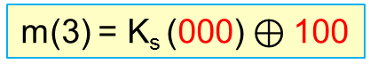
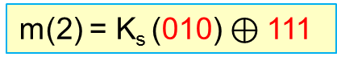
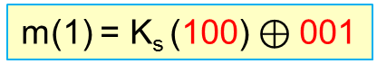
Symmetric Key
Avoid generating the same ciphertext for identical plaintext blocks
Block cipher + rand number: the message is encrypted in blocks of k bits XOR random number.
To decrypt: $\text{K}\text{s}\text{(} \text{) }$ , XOR
Example:
k=3
Step 1. Given c(1), r(1), c(2), r(2), …
Apply K_{s} (c(i)) to each ciphertext c(i)
K_{s} (100), 001, K_{s} (010), 111, K_{s} (000), 100
plaintext = 010 010 010
K_{s} (100)=011, K_{s} (010)=101, K_{s} (000)=110
m(1)
m(2)
m(3)
Step 2. $m\left(i\right)=\text{K}\text{s}\text{(}\text{c}\text{(}\text{i}\text{))} ⊕$ r(i)
m(1) = K_{s} (100) $⊕$001
m(2) = K_{s} (010) $⊕$111
m(3) = K_{s} (000) $⊕$100

Slide 30
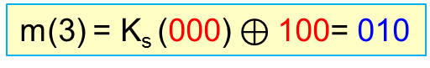
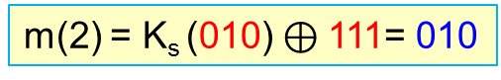
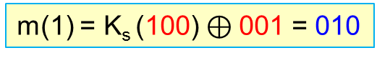
Symmetric Key
Avoid generating the same ciphertext for identical plaintext blocks
Block cipher + rand number: the message is encrypted in blocks of k bits XOR random number.
To decrypt: $\text{K}\text{s}\text{(} \text{) }$ , XOR
Example:
k=3
Step 1. Given c(1), r(1), c(2), r(2), …
Apply K_{s} (c(i)) to each ciphertext c(i)
K_{s} (100), 001, K_{s} (010), 111, K_{s} (000), 100
plaintext = 010 010 010
K_{s} (100)=011, K_{s} (010)=101, K_{s} (000)=110
m(1)
m(2)
m(3)
Step 2. $m\left(i\right)=\text{K}\text{s}\text{(}\text{c}\text{(}\text{i}\text{))} ⊕$ r(i)
m(1) = K_{s} (100) $⊕$001 = 010
m(2) = K_{s} (010) $⊕$111= 010
m(3) = K_{s} (000) $⊕$100= 010

Slide 31
Symmetric Key
Avoid generating the same ciphertext for identical plaintext blocks
Block cipher + rand number: the message is encrypted in blocks of k bits XOR random number.
Step 1. Generate a random k-bit number r(i) for each block i.
r(i) = random number to be used by ith ciphertext block
Step 2. Calculate the ciphertext for each block i.
c(i) = K_{s} (m(i) $⊕$ r(i) )
Step 3. Send c(1), r(1), c(2), r(2), …
Weakness
Due to the required sending of r(i)s, the sender must transmit twice as many bits as the number of cipher bits, doubling the required bandwidth.

Slide 32
Cryptography
Symmetric Key
Cipher Block Chaining
Avoid generating the same ciphertext for identical plaintext blocks
Avoid sending twice the number of ciphertext bits by applying a formula to calculate the sequence of random numbers automatically, except for the very first random number.

Slide 33
Symmetric Key
Avoid sending twice the number of ciphertext bits
Cipher Block Chaining (CBC): the message is encrypted in blocks of k bits XOR random number.
To encrypt: XOR, $\text{K}\text{s}\text{( )}$
Example:
k=3
m(i) = ith plaintext block
c(i) = ith ciphertext block
a $⊕$ b = XOR of two bit strings
K_{s}= block-cipher encryption algorithm with key S
plaintext = 010 010 010
c(0) = IV (Initialisation Vector) = random k-bit string
m(1)
m(2)
m(3)
Step 1. Generate a random k-bit number, store as IV and c(0).
c(0) = IV = random number to be used by 1st ciphertext block
r(1)=c(0)= IV
Step 2. Calculate the ciphertext for block 1.
r(2)=c(1)
c(1) = K_{s} (m(1) $⊕$ c(0) )
r(3)=c(2)

Slide 34
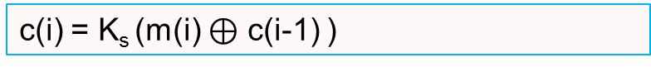
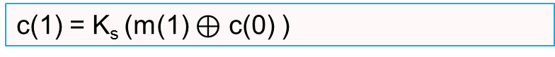
Symmetric Key
Avoid sending twice the number of ciphertext bits
Cipher Block Chaining (CBC): the message is encrypted in blocks of k bits XOR random number.
To encrypt: XOR, $\text{K}\text{s}\text{( )}$
Example:
k=3
Step 1. Generate a random k-bit number, and store as the Initialisation Vector (IV) and c(0).
c(0) = IV = random number to be used by 1st ciphertext block
plaintext = 010 010 010
Step 2. Calculate the ciphertext for block 1.
c(1) = K_{s} (m(1) $⊕$ c(0) )
m(1)
m(2)
m(3)
Step 3. Calculate the remaining ciphertext for block i.
r(1)=c(0)= IV
r(2)=c(1)
c(i) = K_{s} (m(i) $⊕$ c(i-1) )
r(3)=c(2)

Slide 35
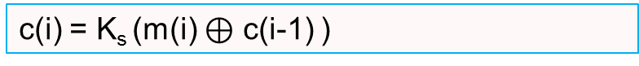

Symmetric Key
Avoid sending twice the number of ciphertext bits
Cipher Block Chaining (CBC): the message is encrypted in blocks of k bits XOR random number.
Example: To encrypt: XOR, $\text{K}\text{s}\text{( )}$
Example:
k=3
Step 1. Generate a random k-bit number, and store as the Initialisation Vector (IV) and c(0).
c(0) = IV = random number to be used by 1st ciphertext block
Step 2. Calculate the ciphertext for block 1.
plaintext = 010 010 010
c(1) = K_{s} (m(1) $⊕$ c(0) )
m(1)
m(2)
m(3)
Step 3. Calculate the remaining ciphertext for block i.
r(1)=c(0)= IV
r(2)=c(1)
c(i) = K_{s} (m(i) $⊕$ c(i-1) )
r(3)=c(2)

Slide 36
Symmetric Key
Avoid sending twice the number of ciphertext bits
Cipher Block Chaining (CBC): the message is encrypted in blocks of k bits XOR random number.
Example: To encrypt: XOR, $\text{K}\text{s}\text{( )}$
Example:
k=3
Step 1. Generate a random k-bit number, and store as the Initialisation Vector (IV) and c(0).
c(0) = IV = 001
c(0) = IV = random number to be used by 1st ciphertext block
Step 2. Calculate the ciphertext for block 1.
plaintext = 010 010 010
c(1) = K_{s} (m(1) $⊕$ c(0) )
m(1)
m(2)
m(3)
Step 3. Calculate the remaining ciphertext for block i.
r(1)=c(0)= IV
r(2)=c(1)
c(i) = K_{s} (m(i) $⊕$ c(i-1) )
r(3)=c(2)

Slide 37
Symmetric Key
Avoid sending twice the number of ciphertext bits
Cipher Block Chaining (CBC): the message is encrypted in blocks of k bits XOR random number.
Example: To encrypt: XOR, $\text{K}\text{s}\text{( )}$
Example:
k=3
Step 1. Generate a random k-bit number, and store as the Initialisation Vector (IV) and c(0).
c(0) = IV = 001
c(0) = IV = random number to be used by 1st ciphertext block
Step 2. Calculate the ciphertext for block 1.
plaintext = 010 010 010
c(1) = K_{s} (m(1) $⊕$ c(0) )
c(1) = K_{s} (m(1) $⊕$ c(0) ) = K_{s} (010 $⊕$ 001 ) =100
m(1)
m(2)
m(3)
Step 3. Calculate the remaining ciphertext for block i.
r(1)=c(0)= IV
r(2)=c(1)
c(i) = K_{s} (m(i) $⊕$ c(i-1) )
r(3)=c(2)

Slide 38
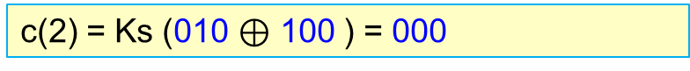
Symmetric Key
Avoid sending twice the number of ciphertext bits
Cipher Block Chaining (CBC): the message is encrypted in blocks of k bits XOR random number.
Example: To encrypt: XOR, $\text{K}\text{s}\text{( )}$
Example:
k=3
Step 1. Generate a random k-bit number, and store as the Initialisation Vector (IV) and c(0).
c(0) = IV = 001
c(0) = IV = random number to be used by 1st ciphertext block
Step 2. Calculate the ciphertext for block 1.
plaintext = 010 010 010
c(1) = K_{s} (m(1) $⊕$ c(0) )
c(1) = K_{s} (m(1) $⊕$ c(0) ) = K_{s} (010 $⊕$ 001 ) =100
m(1)
m(2)
m(3)
Step 3. Calculate the remaining ciphertext for block i.
r(1)=c(0)= IV
r(2)=c(1)
c(i) = K_{s} (m(i) $⊕$ c(i-1) )
c(2) = Ks (010 $⊕$ 100 ) = 000
r(3)=c(2)

Slide 39
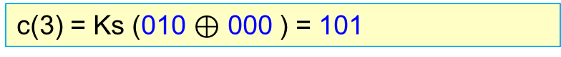
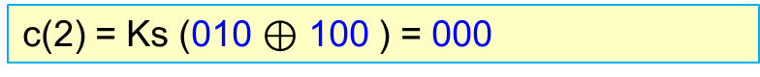
Symmetric Key
Avoid sending twice the number of ciphertext bits
Cipher Block Chaining (CBC): the message is encrypted in blocks of k bits XOR random number.
Example: To encrypt: XOR, $\text{K}\text{s}\text{( )}$
Example:
k=3
Step 1. Generate a random k-bit number, and store as the Initialisation Vector (IV) and c(0).
c(0) = IV = 001
Step 2. Calculate the ciphertext for block 1.
plaintext = 010 010 010
c(1) = K_{s} (m(1) $⊕$ c(0) ) = K_{s} (010 $⊕$ 001 ) =100
m(1)
m(2)
m(3)
Step 3. Calculate the remaining ciphertext for block i.
r(1)=c(0)=IV
c(2) = Ks (010 $⊕$ 100 ) = 000
r(2)=c(1)
c(3) = Ks (010 $⊕$ 000 ) = 101
r(3)=c(2)

Slide 40

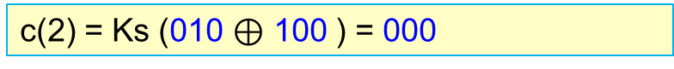
Symmetric Key
Avoid sending twice the number of ciphertext bits
Cipher Block Chaining (CBC): the message is encrypted in blocks of k bits XOR random number.
Example: To encrypt: XOR, $\text{K}\text{s}\text{( )}$
Example:
k=3
Step 1. Generate a random k-bit number, and store as the Initialisation Vector (IV) and c(0).
c(0) = IV = 001
Step 2. Calculate the ciphertext for block 1.
plaintext = 010 010 010
c(1) = K_{s} (m(1) $⊕$ c(0) ) = K_{s} (010 $⊕$ 001 ) =100
Step 3. Calculate the remaining ciphertext for block i.
m(1)
m(2)
m(3)
c(2) = Ks (010 $⊕$ 100 ) = 000
r(1)=c(0)=IV
c(3) = Ks (010 $⊕$ 000 ) = 101
r(2)=c(1)
Step 4. Send c(0),c(1),c(2),c(3)=001,100,000,101
r(3)=c(2)

Slide 41
Symmetric Key
Avoid sending twice the number of ciphertext bits
Cipher Block Chaining (CBC): the message is encrypted in blocks of k bits XOR random number.
Example: To decrypt: $\text{K}\text{s}\text{(} \text{) }$ , XOR
Example:
k=3
Step 1. Given c(0),c(1),c(2),c(3),…
For each ciphertext block, calculate K_{s} (c(i)), starting at i=1
Given c(0),c(1),c(2),c(3)=001,100,000,101
plaintext = 010 010 010
c(0)
c(1)
Ks (c(1))= Ks (100)=011
m(1)
m(2)
m(3)
Ks (c(2))= Ks (000)=110
r(1)=c(0)=IV
Ks (c(3))= Ks (101)=010
r(2)=c(1)
r(3)=c(2)

Slide 42
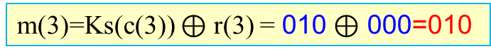
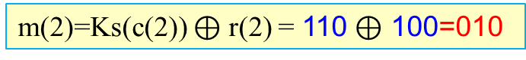
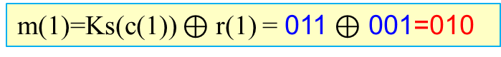
Symmetric Key
Avoid sending twice the number of ciphertext bits
Cipher Block Chaining (CBC): the message is encrypted in blocks of k bits XOR random number.
Example: To decrypt: $\text{K}\text{s}\text{(} \text{) }$ , XOR
Example:
k=3
Step 1. Given c(0),c(1),c(2),c(3),…
For each ciphertext block, calculate K_{s} (c(i)), starting at i=1
Given c(0),c(1),c(2),c(3)=001,100,000,101
Ks (c(1))= Ks (100)=011
Ks (c(2))=110
Ks (c(3))=010
plaintext = 010 010 010
Step 2. For each ciphertext block, calculate m(i)=K_{s}(c(i)) $⊕$ r(i)
m(1)
m(2)
m(3)
m(1)=Ks(c(1)) $⊕$ r(1) = 011 $⊕$ 001=010
r(1)=c(0)=IV
m(2)=Ks(c(2)) $⊕$ r(2) = 110 $⊕$ 100=010
r(2)=c(1)
m(3)=Ks(c(3)) $⊕$ r(3) = 010 $⊕$ 000=010
r(3)=c(2)

Slide 43
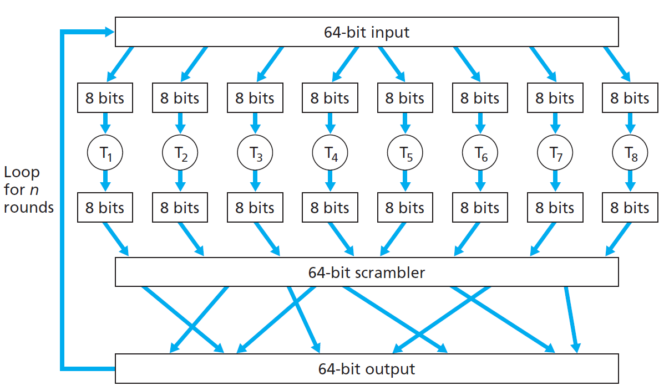
Symmetric Key
Block Cipher
Block cipher: the message is encrypted in blocks of k bits.
Example:
table
output chunk
Publicly known
k=64 bits

Slide 44
Symmetric key crypto: DES
DES: Data Encryption Standard
US encryption standard [NBS 1977, NIST 1993]
Designed by IBM; adopted by the U.S. Government for non-military and non-classified use
56-bit symmetric key, 64-bit plain text input
GOAL:
Completely scramble data and key so that every bit of ciphertext depends on every bit of data and every bit of the key.. With a good algorithm, there should be no correlation between the ciphertext and either the original data or key.
Complete documentation of DES (from NIST):
NIST (National Institute of Standards and Technology)
http://csrc.nist.gov/publications/fips/fips46-3/fips46-3.pdf

Slide 45
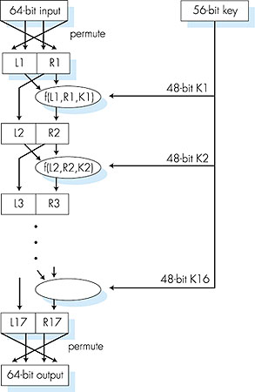
Symmetric key crypto: DES
blocks of data consisting of 64 bits
DES operation
initial permutation
16 identical 'rounds' of function application, each using different 48 bits of key
final permutation
involve multiple rounds
block cipher - plaintext is divided into blocks and use the same key to encrypt and decrypt the blocks
For encrypting longer messages: use cipher-block chaining

Slide 46
DES vs. RSA (Speed of Computation)
The exponentiation required by RSA is a very time-consuming operation.
DES is at least 100 times faster than RSA in software and between 1,000 and 10,000 times faster in hardware.

Slide 47
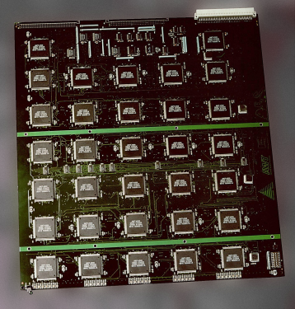
WARNING!
DES is now considered insecure because a brute force attack is possible (see EFF DES cracker). As of 2008, the best analytical attack is linear cryptanalysis, which requires 243 known plaintexts and has a time complexity of 2^{39–43}.
(1998) The EFF's US$250,000 DES cracking machine
The Electronic Frontier Foundation (EFF) is an international non-profit digital rights group based in San Francisco, California.
http://en.wikipedia.org/wiki/Data_Encryption_Standard
Notes:
A chosen-plaintext attack (CPA) is an attack model for cryptanalysis which presumes that the attacker can obtain the ciphertexts for arbitrary plaintexts.^{[1]} The goal of the attack is to gain information which reduces the security of the encryption scheme.

Slide 48
AES: Advanced Encryption Standard
new (Nov. 2001) symmetric-key NIST standard, replacing DES
processes data in 128 bit blocks
128, 192, or 256 bit keys
Assuming that one can break DES in one second (trying 2^56 keys in one second)), then, trying 2^128 keys requires would take 149 trillion years for AES
TOP SECRET information will require use of either the 192 or 256 key lengths.

Slide 49
Bank securely online
Two-Level Authentication
In order to transact on ANZ Digital Banking, users are required to be authenticated twice. The first level authentication is performed through the use of the Username and Password, while the second level is through One-time Password generated with your Security Device or sent to your mobile number registered with ANZ.
128-bit Secure Socket Layer (SSL) encryption
The 128-bit Secure Socket Layer (SSL) encryption is an international standard that other Financial Centres in the world uses for securing data communication between the browser and websites. Digital certificate technology is used to ensure transaction privacy, message integrity and server-side authentication. This serves as an assurance that the website runs legitimately under the care of the Bank.
All data sent to and from ANZ is "scrambled" and "reassembled" between ANZ and your personal computer using 128-bit encryption, the highest level of encryption commercially available.

Slide 50
Bank securely online
Reference:
http://www.anz.com/singapore/en/personal/Ways-Bank/banking-security/online-banking-security/

Slide 51
Special Topic: Network Security
WanaCry Ransomware
a malicious computer virus, spread by a worm

Slide 52
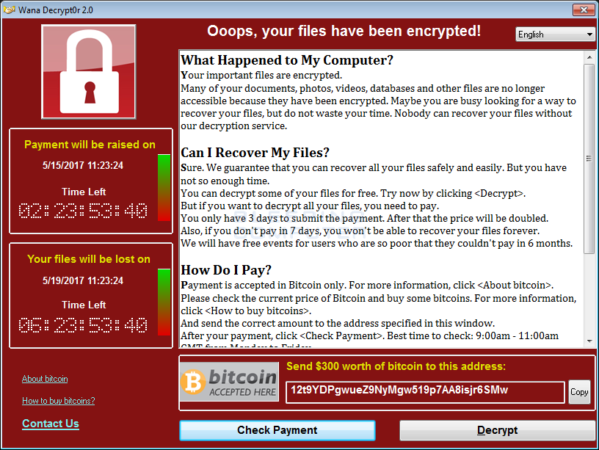
Wana Decryptor Ransomware
The WannaCry Ransomware is a computer infection that is designed to encrypt your files so that you are unable to open them and then demand a ransom in bitcoins to get the decryption key. (heavily distributed on 12th of May 2017, more than 200,000 computers, in 150 countries have been affected so far.)
Bitcoin: People can spend their Bitcoins fairly anonymously. Although all transactions are recorded, nobody would know which 'account number' was yours unless you told them. Every transaction is recorded publicly so it's very difficult to copy Bitcoins, make fake ones or spend ones you don't own.
Ref: https://www.bleepingcomputer.com/news/security/wana-decrypt0r-ransomware-using-nsa-exploit-leaked-by-shadow-brokers-is-on-a-rampage/

Slide 53
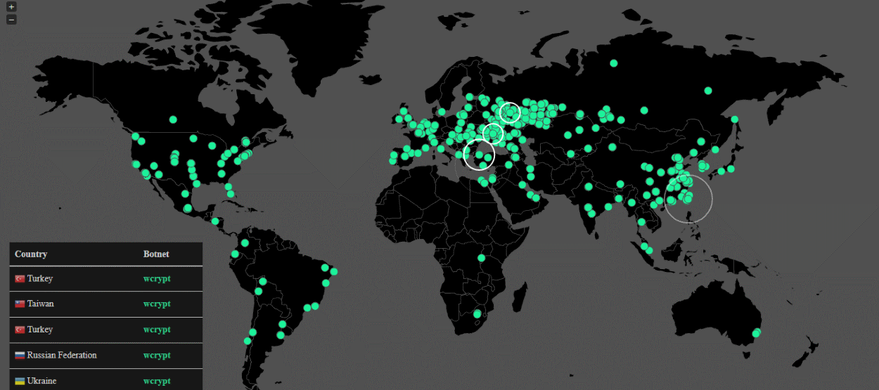
Wana Decryptor Ransomware Using NSA Exploit Leaked by Shadow Brokers Is on a Rampage
England, 48 National Health Service (NHS) trusts reported problems at hospitals, doctor surgeries or pharmacies, and 13 NHS organisations in Scotland,
Germany's rail network Deutsche Bahn, Spanish telecommunications operator Telefonica, French carmaker Renault, US logistics giant FedEx and Russia's Interior Ministry.
MalwareHunterTeam first spotted WanaCrypt0r a few weeks ago, but the ransomware for the most part was hardly distributed.
Suddenly, WannaCry exploded and began spreading like wild fire through an exploit called ETERNALBLUE.
ETERNALBLUE is an alleged NSA exploit leaked online last month by a nefarious group known as The Shadow Brokers.
Ref: https://www.bleepingcomputer.com/news/security/wana-decrypt0r-ransomware-using-nsa-exploit-leaked-by-shadow-brokers-is-on-a-rampage/

Slide 54
How does WannaCry Spread?
This ransomware is spreads through a Worm executable that scans the Internet for Windows servers that have the Samba TCP port 445 accessible.
This port is the SMB port that the ETERNALBLUE exploit uses to gain access to a computer.
When the Worm gains access to a computer it will create a copy of itself and execute the program on the infected computer.
Once the Worm is running on the computer, it connects to the iuqerfsodp9ifjaposdfjhgosurijfaewrwergwea.com domain.
If able to connect, exit program. (a kill switch for the spreading of the ransomware and was discovered accidentally when a security researcher registered the domain to get statistics on infections.)
If unable to connect to the above domain, it extracts a password protected ZIP file to the same folder as the Worm program. This zip file contains the ransomware, which is then executed and encrypts the files on the victim's computer.
Ref: https://www.bleepingcomputer.com/news/security/wannacry-wana-decryptor-wanacrypt0r-technical-nose-dive/

Slide 55
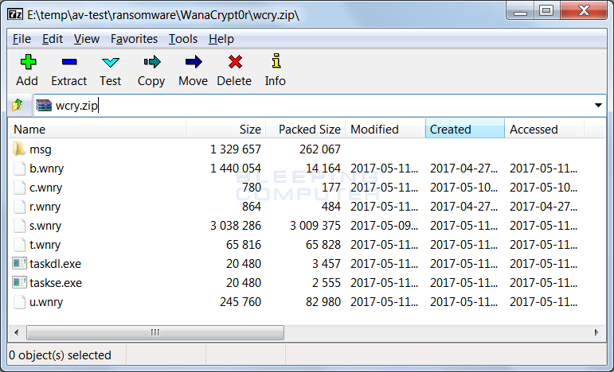
WannaCry: Details of Operations
The worm extracts an embedded file (password-protected zip file) into the same folder that the worm is located in. Then, it performs some startup tasks.
extract localized version of the ransom notes into the msg folder
Bulgarian, Chinese (simplified), Chinese (traditional), Croatian, Czech, Danish, Dutch, English, Filipino, Finnish, French, German, Greek, Indonesian, Italian, Japanese, Korean, Latvian, Norwegian, Polish, Portuguese, Romanian, Russian, Slovak, Spanish, Swedish, Turkish, Vietnamese,

Slide 56
Tor Client and Server
download a TOR client from https://dist.torproject.org/torbrowser/6.5.1/tor-win32-0.2.9.10.zip and extract it into the TaskData folder.
TOR client is used to communicate with the ransomware C2 servers at:
gx7ekbenv2riucmf.onion
57g7spgrzlojinas.onion
xxlvbrloxvriy2c5.onion
76jdd2ir2embyv47.onion
cwwnhwhlz52maqm7.onion

Slide 57

anonymous communication
Tor is free software for enabling anonymous communication
Using Tor makes it more difficult for Internet activity to be traced back to the user: this includes "visits to Web sites, online posts, instant messages, and other communication forms
Tor directs Internet traffic through a free, worldwide, volunteer network consisting of more than seven thousand relays to conceal a user's location and usage from anyone conducting network surveillance or traffic analysis.
Tor's use is intended to protect the personal privacy of users, as well as their freedom and ability to conduct confidential communication by keeping their Internet activities from being monitored.

Slide 58
WannaCry: Details of Operations
execute command:
icacls . /grant Everyone:F /T /C /Q
This is done in order to give everyone full permissions to the files located in the folder and subfolders under where the ransomware was executed

Slide 59
WannaCry: Details of Operations
execute commands:
taskkill.exe /f /im mysqld.exe
taskkill.exe /f /im sqlwriter.exe
taskkill.exe /f /im sqlserver.exe
taskkill.exe /f /im MSExchange*
taskkill.exe /f /im Microsoft.Exchange.*
This is done in order to terminate the database and exchange server processes, so it can encrypt databases and mail stores as well.

Slide 60
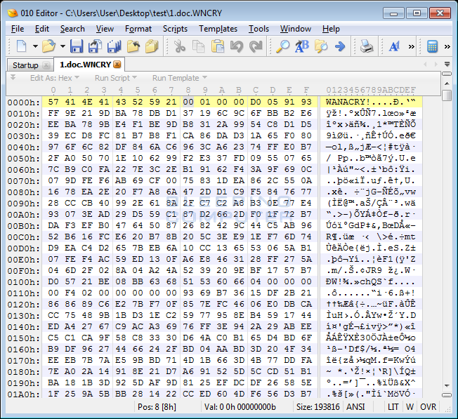
WannaCry: Details of Operations
scan all drives and mapped network drives for files that have one of the following extensions:
.der, .pfx, .key, .crt, .csr, .pem, .odt, .ott, .sxw, .stw, .uot, .max, .ods, .ots, .sxc, .stc, .dif, .slk, .odp, .otp, .sxd, .std, .uop, .odg, .otg, .sxm, .mml, .lay, .lay6, .asc, .sqlite3, .sqlitedb, .sql, .accdb, .mdb, .dbf, .odb, .frm, .myd, .myi, .ibd, .mdf, .ldf, .sln, .suo, .cpp, .pas, .asm, .cmd, .bat, .vbs, .dip, .dch, .sch, .brd, .jsp, .php, .asp, .java, .jar, .class, .wav, .swf, .fla, .wmv, .mpg, .vob, .mpeg, .asf, .avi, .mov, .mkv, .flv, .wma, .mid, .djvu, .svg, .psd, .nef, .tiff, .tif, .cgm, .raw, .gif, .png, .bmp, .jpg, .jpeg, .vcd, .iso, .backup, .zip, .rar, .tgz, .tar, .bak, .tbk, .PAQ, .ARC, .aes, .gpg, .vmx, .vmdk, .vdi, .sldm, .sldx, .sti, .sxi, .hwp, .snt, .onetoc2, .dwg, .pdf, .wks, .rtf, .csv, .txt, .vsdx, .vsd, .edb, .eml, .msg, .ost, .pst, .potm, .potx, .ppam, .ppsx, .ppsm, .pps, .pot, .pptm, .pptx, .ppt, .xltm, .xltx, .xlc, .xlm, .xlt, .xlw, .xlsb, .xlsm, .xlsx, .xls, .dotx, .dotm, .dot, .docm, .docb, .docx, .doc,
Perform encryption of files
if a user uses a cloud storage service and regularly synchronizes their locate data with the cloud, the files on the cloud will be overwritten by the encrypted versions.

Slide 61
WannaCry: Details of Operations
clear the Shadow Volume Copies, disable Windows startup recovery, clear Windows Server Backup history.
Execute command:
C:\Windows\SysWOW64\cmd.exe /c vssadmin delete shadow /all /quiet & wmic shadowcopy delete & bcdedit /set {default} boostatuspolicy ignoreallfailures & bcdedit /set {default} recoveryenabled no & wbadmin delete catalog -quiet

Slide 62
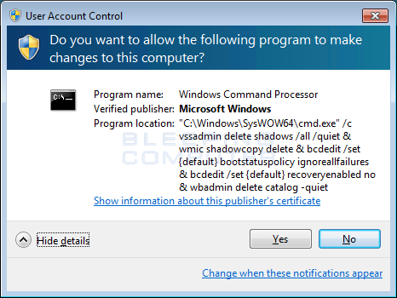
WannaCry: Details of Operations
As these commands require Administrative privileges, victims will see a UAC prompt similar to the one below.

Slide 63
WannaCry: Details of Operations
Display lockscreen
There are three hard-coded bitcoin addresses in the WanaCrypt0r ransomware:
13AM4VW2dhxYgXeQepoHkHSQuy6NgaEb94
12t9YDPgwueZ9NyMgw519p7AA8isjr6SMw
115p7UMMngoj1pMvkpHijcRdfJNXj6LrLn.
Once Check Payment button is clicked, the ransomware connects back to the TOR C2 servers to see if a payment has been made.

Slide 64
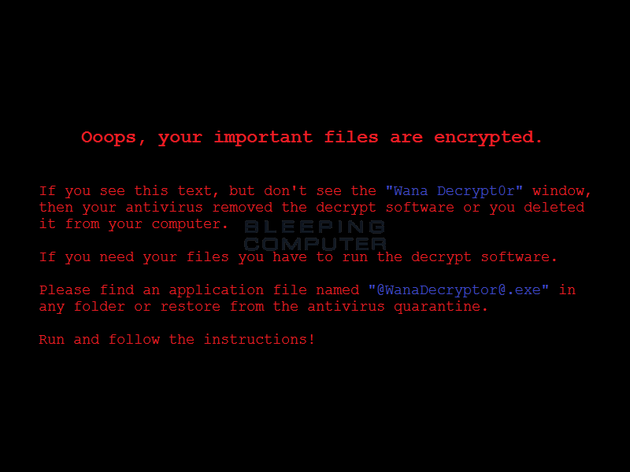
WannaCry: Details of Operations
Change wallpaper

Slide 65
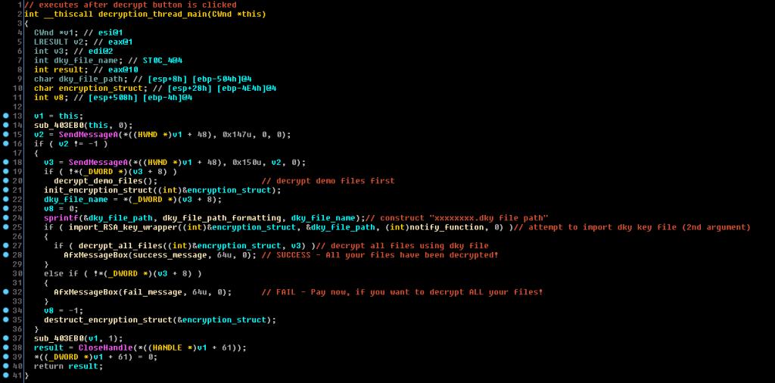
WanaCry: Encryption/Decryption
RSA: The malware contains two separate decryption/encryption routines- one for the bulk of the victims’ files, encrypted with a unique key per file. To decrypt the files, a private RSA key is needed from the creators, who are supposed to deliver it in a “.dky” file.
http://blog.checkpoint.com/2017/05/14/wannacry-paid-time-off/

Slide 66
According to Microsoft
Server Message Block (SMB v1 and v2)
The most severe of the vulnerabilities could allow remote code execution if an attacker sent a specially crafted SMB packet to a computer running the Server service.
Firewall best practices and standard default firewall configurations can help protect networks from attacks that originate from outside the enterprise perimeter
Best practices recommend that systems that are connected to the Internet have a minimal number of ports exposed.
Ref: https://technet.microsoft.com/library/security/ms09-050

Slide 67
According to Microsoft
Server Message Block (SMB v1 and v2)
Risk: Critical
Affected Software:
Almost all Windows-based systems
For the complete list: https://technet.microsoft.com/en-us/library/security/ms17-010.aspx
As the Worm spreads by using a vulnerability in SMBv1, which Microsoft patched in March as part of security bulletin MS17-010, it is necessary that everyone update their computers.
Microsoft has also released a update for Windows XP, Windows 8, and Windows Server 2003, which typically no longer receive security updates.

Slide 68
Ransomware removal
STEP 1: Use Rkill to terminate suspicious programs.
STEP 2: Scan and clean your computer with Emsisoft Anti-Malware
STEP 3: Use Malwarebytes AntiMalware to Scan for Malware and Unwanted Programs

Slide 69
Summary of leaked data from NSA
EASYBEE appears to be an MDaemon email server vulnerability [source, source, source]
EASYPI is an IBM Lotus Notes exploit [source, source] that gets detected as Stuxnet [source]
EWOKFRENZY is an exploit for IBM Lotus Domino 6.5.4 to 7.0.2 [source, source]
EXPLODINGCAN is an IIS 6.0 exploit that creates a remote backdoor [source, source]
ETERNALROMANCE is a SMBv1 exploit over TCP port 445 which targets XP, 2003, Vista, 7, Windows 8, 2008, 2008 R2, and gives SYSTEM privileges [source, source]
EDUCATEDSCHOLAR is a SMB exploit [source, source]
EMERALDTHREAD is a SMB exploit for Windows XP and Server 2003 [source, source]
EMPHASISMINE is a remote IMAP exploit for IBM Lotus Domino [source, source]
ENGLISHMANSDENTIST sets Outlook Exchange WebAccess rules to trigger executable code on the client's side to send an email to other users [source, source]
ERRATICGOPHER is a SMBv1 exploit targeting Windows XP and Server 2003 [source, source]
ETERNALSYNERGY is a SMBv3 remote code execution flaw for Windows 8 and Server 2012 [source, source, source]
ETERNALBLUE is a SMBv2 exploit [source]
ETERNALCHAMPION is a SMBv1 exploit [source]
ESKIMOROLL is a Kerberos exploit targeting 2000, 2003, 2008 and 2008 R2 domain controllers [source, source]
ESTEEMAUDIT is an RDP exploit and backdoor for Windows Server 2003 [source, source]
ECLIPSEDWING is an RCE exploit for the Server service in Windows Server 2008 and later [source, source]
EXPANDINGPULLEY is another Windows implant [source]
GROK is a keylogger for Windows, also known about since Snowden [source]
ETRE is an exploit for IMail 8.10 to 8.22 [source]

Slide 70
Summary of leaked data from NSA
FUZZBUNCH is an exploit framework, similar to MetaSploit [source, source], which was also part of the December-January "Windows Tools" Shadow Brokers auction [source]
DOUBLEPULSAR is a RING-0 multi-version kernel mode payload [source]
PASSFREELY is a tool that bypasses authentication for Oracle servers [source]
EquationGroup had scripts that could scrape Oracle databases for SWIFT data [source, source]
ODDJOB is an implant builder and C&C server that can deliver exploits for Windows 2000 and later [source, source], also not detected by any AV vendors [source]
Metadata [possibly faked, possibly real] links NSA to Equation Group [source]
NSA used TrueCrypt for storing operation notes [source]
Some of the Windows exploits released today were undetectable on VirusTotal [source]
Some EquationGroup humor in the oddjob instructions manual [source, source]
JEEPFLEA_MARKET appears to be an operation for collecting data from several banks around the world [source], previously linked to the NSA by Snowden [source, source]
The Equation Group targeted EastNets, a SWIFT connectivity provider [source, source, source, source, source]
https://www.bleepingcomputer.com/news/security/shadow-brokers-release-new-files-revealing-windows-exploits-swift-attacks/

Slide 71
Cryptography
Public Key
Notes:
TCP
PIPE-LINED PROTOCOL
SEQUENCE NUMBER - Uses byte-stream order of data
CUMULATIVE ACK
1 TIMER CONTROL – associated with the oldest unACKed segment
Dynamically estimates the Timeout interval using an Exponential Weighted Moving Average technique
Buffers out-of-order segments
Employs a flow control mechanism
Employs a congestion control mechanism
Tries to allocate bandwidth fairly among users of TCP.

Slide 72
Public Key Cryptography
Is it possible to communicate with encryption without having a shared secret key known in advance?
symmetric key crypto
requires sender, receiver know shared secret key
Q: how to agree on key in first place (particularly if never met)?
Typical problem in the Internet
public key cryptography
radically different approach [Diffie-Hellman76, RSA78]
sender, receiver do not share a secret key
encryption key public (known to all)
decryption key private (known only to receiver)

Slide 73
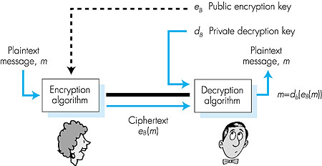
Public key cryptography
Figure 7.7 goes here

Slide 74
Public key encryption algorithms
Two inter-related requirements:
.
.
1
need d ( ) and e ( ) such that
B
B
d (e (m)) = m
B
B
2
need public and private keys
for d ( ) and e ( )
.
.
B
B
RSA: Rivest, Shamir, Adleman algorithm

Slide 75

RSA: Choosing keys
1. Choose two large prime numbers p, q.
(e.g., 1024 bits each)
defines the range
2. Compute n = pq, z = (p-1)(q-1)
3. Choose e (with e < n) that has no common factors
with z. (e, z are 'relatively prime‘ or coprime).
e should also be different than p,q
4. Choose d such that ed-1 is exactly divisible by z.
(in other words: ed mod z = 1 ).
5. Public key is (n,e). Private key is (n,d).
In mathematics, a prime number (or a prime) is a natural number that has exactly two (distinct) natural number divisors, which are 1 and the prime number itself. The first 30 prime numbers are 2, 3, 5, 7, 11, 13, 17, 19, 23, 29, 31, 37, 41, 43, 47, 53, 59, 61, 67, 71, 73, 79, 83, 89, 97, 101, 103, 107, 109, and 113

Slide 76
RSA: Encryption, decryption
0. Given (n,e) and (n,d) as computed above
1. To encrypt bit pattern, m, compute
e
e
c = m mod n
(i.e., remainder when m is divided by n)
2. To decrypt received bit pattern, c, compute
d
d
m = c mod n
(i.e., remainder when c is divided by n)
Magic
happens!
d
e
m = (m mod n)
mod n

Slide 77
RSA: an important property
The following property will be very useful later:
-
+
+
-
K (K (m)) = m
=
K (K (m))
B
B
B
B
use public key first, followed by private key
use private key first, followed by public key
result is the same!

Slide 78
Why is RSA secure?
suppose you know Bob’s public key (e,n). How hard is it to determine d?
essentially need to find factors of n without knowing the two factors p and q
fact: factoring a big number is hard

Slide 79
RSA:how strong is it??
RSA Challenges:
Prize offered to anyone who can break an RSA key of a certain size
(See www.rsasecurity.com/rsalabs)
US$200,000.00 for whoever solves a 2048 bit factorization problem. No one claimed the prize so far...
Last challenge solved:
RSA-576 $10,000 Factored in 2003 by J. Franke et al.
Using a powerful parallel machine and very clever algorithms
Currently RSA-1024 is commonly used in practice
RSA key's size matters, see next...

Slide 80
RSA
Example: Single letter

Slide 81
RSA example:
Bob chooses p=5, q=7. Then n=35, z=24.
e=5 (so e and z are relatively prime).
d=29 (so ed-1 exactly divisible by z.)
m
e
e
letter
m
c = m mod n
encrypt:
l
12
248832
17
c
d
d
decrypt:
c
m = c mod n
letter
17
12
l
d
c
=
481968572106750915091411825223072000 - too big !! (int type)
There’s an efficient way of solving this!
(will be discussed later)

Slide 82
RSA
Example: string of characters

Slide 83
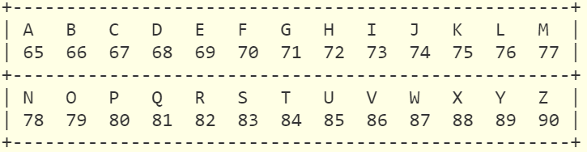
Example
ASCII table (capital letters):

Slide 84
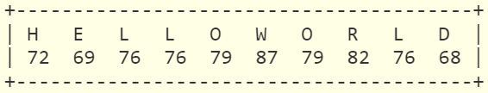
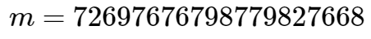
Example
Plain text, and its ASCII equivalent:
After concatenation,

Slide 85
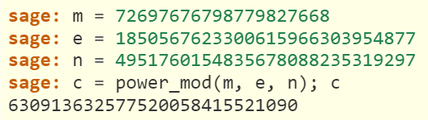
Example
Computing for the cipher text,

Slide 86
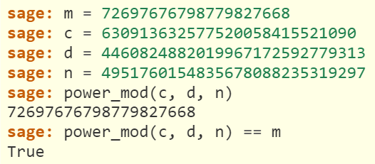
Example
Recovering the plain text and testing for equivalence,
Given:

Slide 87
RSA
Computing for d
Notes:
TCP
PIPE-LINED PROTOCOL
SEQUENCE NUMBER - Uses byte-stream order of data
CUMULATIVE ACK
1 TIMER CONTROL – associated with the oldest unACKed segment
Dynamically estimates the Timeout interval using an Exponential Weighted Moving Average technique
Buffers out-of-order segments
Employs a flow control mechanism
Employs a congestion control mechanism
Tries to allocate bandwidth fairly among users of TCP.

Slide 88
RSA: Computing for d
Trial and error approach
Choose p=5, q=7.
Then n=35, z=(5-1)(7-1)=24.
e=? (so e, z relatively prime).
Could not be 3, but could be 5,7,11,13 etc...
choose e=5 (a better choice would be e≠p...)
d=? For really small numbers, by trial and error:
try d=11,13,17...29 until
d=29 (so ed-1 exactly divisible by z).

Slide 89
Issues with this simplistic example:
Trial and error approach
e should be different than p,q
Once we choose e, how to find d?
Trial and error will not solve it for large keys!
In practice, use a bigger number, e.g. e=65537 (e=3 is weak)
Solution: Use Extended Euclidean Algorithm to find a suitable d

Slide 90
How can we check if the e that we picked is a coprime
of z?
We can apply the Euclidean algorithm for solving this.

Slide 91
Euclidean Algorithm
How can we check if the e that we picked is a coprime
of z?
an efficient method for computing the greatest common divisor (gcd) of two numbers
gcd - the largest number that divides both of them without leaving a remainder.
If e & z are coprimes, then their gcd must be 1.

Slide 92
Euclidean Algorithm gcd(a,b):
Find the gcd of two numbers, a and b
Check if e & z are coprimes.
An example of the Euclid's algorithm:
say, p=11, q=5, and e=7. So, n=55 and z=40
Making sure that e and z are relative primes:
Dividend | Divisor | Remainder | Quotient
40 | 7 |  | 5
(int)40 / 7
Use z as the dividend, and e as divisor.
Calculate their integer quotient.

Slide 93
Euclidean Algorithm gcd(a,b):
Find the gcd of two numbers, a and b
Check if e & z are coprimes.
An example of the Euclid's algorithm:
say, p=11, q=5, and e=7. So, n=55 and z=40
Making sure that e and z are relative primes:
Dividend | Divisor | Remainder | Quotient
40 | 7 | 5 | 5
remainder((int)40 / 7 )
Use z as the dividend, and e as divisor.
Calculate the remainder of the division operation.

Slide 94
Euclidean Algorithm gcd(a,b):
Find the gcd of two numbers, a and b
Check if e & z are coprimes.
An example of the Euclid's algorithm:
say, p=11, q=5, and e=7. So, n=55 and z=40
Making sure that e and z are relative primes:
Dividend | Divisor | Remainder | Quotient
40 | 7 | 5 | 5
7 | 5 | 2 | 1
5 | 2 | 1 | 2
2 | 1 | 0 | 2
When the remainder turns to 0, check to see if the divisor is 1
Stop when the remainder turns to 0
gcd(z,e) = 1
Therefore, z and e are coprimes.

Slide 95
How to calculate for d such that ed mod z = 1?
We can apply Bézout's identity in solving this.

Slide 96
Solving for d
Detailed analysis
There exist two integers x,y that satisfy:
where a,b are also integers, and
gcd(a,b) is their greatest common divisor
This is called the Bézout's identity.
If we think a,b are z,e then we know that:
gcd(z,e) = 1 (they are relatively primes)
ax + by = gcd(a,b)
Now we can solve for d
Is it ok to write this?
zx + ey = gcd(z,e)=1
zx + ed = gcd(z,e)=1
How does this equation relate to ed mod z = 1?

Slide 97
Solving for d
Detailed analysis
zx + ed = gcd(z,e)=1
Is it ok to write this?
zx + ed = 1
(zx + ed) mod z = 1 mod z
(zx mod z) + (ed mod z) = 1
0 + ed mod z = 1
ed mod z = 1
zx mod z=?
Let z=5
5x mod 5 = ?
Let x=1
5 mod 5 = 0
Let x=2
10 mod 5 = 0
Therefore,
zx mod z = 0
ed mod z = 1
How does this equation relate to ed mod z = 1?

Slide 98
Given a and b, find x and y that satisfies the equation:
ax + by = gcd(a,b)
where a = z, and b = e.
zx + ed = gcd(z,e)=1
Solving for y is the same as solving for d.
We can use the Extended Euclidean Algorithm in solving this.

Slide 99
Extended Euclidean Algorithm:
Long method
ax + by = gcd(a,b)
Initial values
An example with z=40 and e=7 again:
zx + ed
step | (int) quotient | remainder |  | ax + by
1 |  | 40 |  | 40=40*1+7*0
2 |  | 7 |  | 7=40*0+7*1
3 | 5 | 5 | =(40*1+7*0)*(1)+(40*0+7*1)*(-5) | 5=40*1+7*(-5)
4 | 1 | 2 |  | 2=40*(-1)+7*6
5 | 2 | 1 |  | 1=40*3+7*(-17)
6 | 2 | 0
gcd(40,7) = 1
stop at this row!
Problem: we found that d=-17
But we want a positive value for d: 40*(3-7)+7*(-17+40)=40*(-4)+7*(23) = 1
So d=23 is what we will use.
Notes:
1. Place z at the remainder column. Calculate for x and y.
2. Place e at the remainder column. Calculate for x and y.
3. Calculate for the integer quotient (z/e) and remainder of (z/e). Calculate for x and y.
4. Repeat step 3, until remainder is 1.

Slide 100
How to automate the calculations for d ?

Slide 101
Extended Euclidean Algorithm:
The Extended Euclidean Algorithm can compute x,y
given a,b...
For each step, compute the expression:
r_{i} = r_{i-2} - q_{i} r_{i-1}
Starting with r₁ = a and r₂ = b
The last row gives us x and y

Slide 102
Extended Euclidean Algorithm:
For automated computation of d
ax + by = gcd(a,b)
Using a table with z=40 and e=7:
d
gcd
quotient
step | x | y | w | k
1 | 1 | 0 | 40
2 | 0 | 1 | 7
3 | … | … | …
STEPS
k_{i}=(int)w_{i-1}/w_{i}
x_{i} = x_{i-2} - k_{i-1} x_{i-1}
y_{i} = y_{i-2} - k_{i-1} y_{i-1}
w_{i} = w_{i-2} - k_{i-1} w_{i-1}
Initial values

Slide 103
Extended Euclidean Algorithm:
STEPS
k_{i}=(int)w_{i-1}/w_{i}
x_{i} = x_{i-2} - k_{i-1} x_{i-1}
y_{i} = y_{i-2} - k_{i-1} y_{i-1}
w_{i} = w_{i-2} - k_{i-1} w_{i-1}
Using a table with z=40 and e=7:
d
gcd
(int)quotient
step | x | y | w | k
1 | 1 | 0 | 40
2 | 0 | 1 | 7 | 5
Solve for Step 1.
ax + by = gcd(a,b)

Slide 104
Extended Euclidean Algorithm:
STEPS
k_{i}=(int)w_{i-1}/w_{i}
x_{i} = x_{i-2} - k_{i-1} x_{i-1}
y_{i} = y_{i-2} - k_{i-1} y_{i-1}
w_{i} = w_{i-2} - k_{i-1} w_{i-1}
Using a table with z=40 and e=7:
d
gcd
(int)quotient
step | x | y | w | k
1 | 1 | 0 | 40
2 | 0 | 1 | 7 | 5
3 | 1 | -5 | 5 | 1
Step 2.
Step 3.
Step 4.
ax + by = gcd(a,b)

Slide 105
Extended Euclidean Algorithm:
STEPS
k_{i}=(int)w_{i-1}/w_{i}
x_{i} = x_{i-2} - k_{i-1} x_{i-1}
y_{i} = y_{i-2} - k_{i-1} y_{i-1}
w_{i} = w_{i-2} - k_{i-1} w_{i-1}
Using a table with z=40 and e=7:
d
gcd
(int)quotient
step | x | y | w | k
1 | 1 | 0 | 40
2 | 0 | 1 | 7 | 5
3 | 1 | -5 | 5 | 1
4 | -1 | 6 | 2 | 2
5 | 3 | -17 | 1
6
gcd(40,7) = 1
stop at this row!
If d is negative, d=d+z will be suitable d=-17+40=23
d=23. Done!

Slide 106
Extended Euclidean Algorithm:
STEPS
k_{i}=(int)w_{i-1}/w_{i}
x_{i} = x_{i-2} - k_{i-1} x_{i-1}
y_{i} = y_{i-2} - k_{i-1} y_{i-1}
w_{i} = w_{i-2} - k_{i-1} w_{i-1}
Given: p=7, q=11, z=60 and e=13, find d.
d
gcd
(int)quotient
step | x | y | w | k
1 | 1 | 0 | 60
2 | 0 | 1 | 13
3
4
5
6
d = ?

Slide 107
Summary of Techniques
Check if e & z are coprimes.
Euclidean Algorithm gcd(e,z):
Solve for d
Extended Euclidean Algorithm
zx + ed = gcd(z,e)=1
Bézout's identity.

Slide 108
RSA
Avoiding overflows when computing exponential equations
Notes:
TCP
PIPE-LINED PROTOCOL
SEQUENCE NUMBER - Uses byte-stream order of data
CUMULATIVE ACK
1 TIMER CONTROL – associated with the oldest unACKed segment
Dynamically estimates the Timeout interval using an Exponential Weighted Moving Average technique
Buffers out-of-order segments
Employs a flow control mechanism
Employs a congestion control mechanism
Tries to allocate bandwidth fairly among users of TCP.

Slide 109
Prerequisite: modular arithmetic
x mod n = remainder of x when divided by n
facts:
[(a mod n) + (b mod n)] mod n = (a+b) mod n
[(a mod n) - (b mod n)] mod n = (a-b) mod n
[(a mod n) * (b mod n)] mod n = (a*b) mod n
thus
(a mod n)^{d} mod n = a^{d} mod n
example: a=9, n=13, d=2:
(a mod n)^{d} mod n = (9² mod 13) mod 13 = 3 a^{d} = 9² = 81 81^{d} mod 13 = 3

Slide 110
Back to the previous RSA example:
For p=5, q=7. Then n=35, z=24.
e=5 (so e, z relatively prime).
d=29 (so ed-1 exactly divisible by z).
m
e
e
letter
m
c = m mod n
encrypt:
l
12
248832
17
c
d
d
decrypt:
c
m = c mod n
letter
17
12
l
d
c
=
481968572106750915091411825223071697 - too big !! (int type)‏

Slide 111
Calculating powers rapidly
Solve 11⁴³ mod 13 = ?
Break it into powers that are multiples of 2.
43 = 1 + 2 + 8 +32
11⁴³ = 11 * 11² * 11⁸ * 11³²
Calculation of sequence: 11 * 11² * 11⁸ * 11³²
11² mod 13 = 4 (mod 13)
11⁴ mod 13 = (11²)² mod 13 = 4² (mod 13)=3 (mod 13)
11⁸ mod 13 = (11⁴)² mod 13 = 3² (mod 13)=9 (mod 13)
11¹⁶ mod 13 = (11⁸)² mod 13 = 9² (mod 13)=3 (mod 13)
11³² mod 13 = (11¹⁶)² mod 13 = 3² (mod 13)=9 (mod 13)
Putting this together,
11⁴³ (mod 13)= 11 * 4 * 9 * 9 (mod 13)
= 44 * 81 (mod 13)
= 5 * 3 (mod 13)
= 2 (mod 13)
Sum of powers of 2:
=2⁰ + 2¹+ 2³ + 2⁵
remember, 11⁴³ = 11 * 11² * 11⁸ * 11³²
Ref: http://web.math.princeton.edu/math_alive/Crypto/Lab2/FastPower.html

Slide 112
How to solve overflow problems:
17²⁹ mod 35=?
C^{d}=17²⁹: break it into powers that are multiples of 2.
17²⁹=17¹⁶ .17⁸ .17⁴. 17
17⁴ mod 35 = 11; hence, = 11 mod 35,
So 11 can substitute into 17⁴, 17⁸, and 17¹⁶ in the expression:
17²⁹ mod 35 = 11⁴ . 11² . 11 . 17 mod 35
Also 11² mod 35 = 16
17²⁹ mod 35 = 16² . 16 . 11 . 17 mod 35
This is equivalent to: calculate x, y and z as follows:
x = n⁴ mod 35
y = x² mod 35
z = y² mod 35
m = z . y . x . c mod 35 (smaller !!)‏
Alternatively: use a similar method to the one used in CRC.
Remember that (c.c.c) mod n = (c.c) (c mod n) ….

Slide 113
Even better solution:
Repeated Squaring: calculate y = x ^{e} mod n
int repeatsquare( int x, int e, int n) {
y=1;//initialize y to 1, very important
while (e > 0) {
if (( e % 2 ) == 0) {// e is an even number
x = (x*x) % n;
e = e/2;
}
else { // e is an odd number
y = (x*y) % n;
e = e-1;
}
}
return y; //the result is stored in y
}
This is the key to be used
c = m^{e} mod n
m = c^{d} mod n

Slide 114
Even better solution:
Repeated Squaring: calculate y = x ^{e} mod n
int repeatsquare( int x, int e, int n) {
y=1;//initialize y to 1, very important
while (e > 0) {
if (( e % 2 ) == 0) {// e is an even number
x = (x*x) % n;
e = e/2;
}
else { // e is an odd number
y = (x*y) % n;
e = e-1;
}
}
return y; //the result is stored in y
}
Example:
calculate y = 24³ mod 33
x=24, e=3, n=33
Step | e | x | y
1 | 3 | 24 | 1
2 | 3-1=2 | 24 | (1*24)%33=24
3 | 2/2=1 | 24² %33=15 | 24
4 | 1-1=0 |  | (15*24)%33=30
Notes:
C:\CORE\Massey_Papers_2016\159334-2016\159334\Demo\RSA>

Slide 115
Unconcealed
c = m^{e} mod n
Avoid the following values of m, as they cannot be concealed by the algorithm:
m = 0, 1 and n-1 will always give the same cipher value no matter how large n is.
http://www.di-mgt.com.au/rsa_alg.html

Slide 116
Network Security
Authentication

Slide 117
Authentication
Process of proving one’s identity to someone else over a network
“live” party (often routers, client-server processes)
Cannot rely on biometric information
Must be done solely on the basis of messages and data exchanged
Must be performed before other protocols:
E.g.
Reliable data transfer protocol
Routing information exchange protocol
E-mail protocol
Next
Let’s see a stepwise evolution of a design of an authentication protocol (ap)

Slide 118
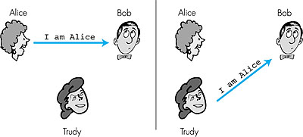
Authentication
Goal: Bob wants Alice to prove her identity to him
Protocol ap1.0: Alice says ''I am Alice''
Failure scenario??

Slide 119
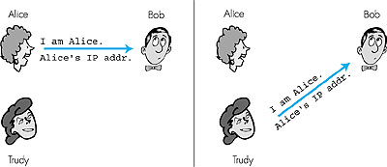
Authentication: using IP
Protocol ap2.0: Alice says ''I am Alice'' and sends her IP
address along to prove it.
Failure scenario??
Create an Operating system kernel that sends an IP datagram using Alice’s IP address
Not unless first-hop router of Trudy would prevent it

Slide 120
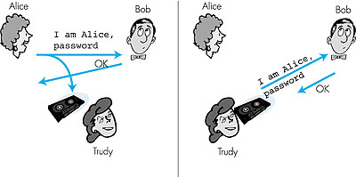
Authentication: Secret Password
Protocol ap3.0: Alice says ''I am Alice'' and sends her
secret password to prove it.
Failure scenario?
Passwords are sent as cleartext for some applications (e.g. Telnet). Within the same LAN, it can be sniffed
WireShark

Slide 121
Authentication: Encrypted Secret Password
Protocol ap3.1: Alice says ''I am Alice'' and sends her
encrypted secret password to prove it.
Assumption: Symmetric key cryptography is employed
Shared Secret key
I am Alice
encrypt(password)
Failure scenario?
Playback attack:
record encrypted password, playback encrypted password version to Bob to pretend that she is Alice
*Password is not learned by Trudy
Pitfall: same password is used over and over again.

Slide 122
Playback Attack
How to solve it?
Failure Scenario:
Bob cannot distinguish between the original authentication and its playback version
Countermeasures:
Use a different password each time
use a sequence of passwords or password generator (could be a number)
apply encryption algorithm to each password
Bob knows: Alice is indeed sending the datagram, because she knows the secret encryption key, and she is sending it “live” because she is using the number recently generated by Bob.

Slide 123
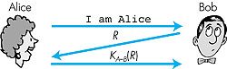
Authentication: Sequence of Encrypted Secret Passwords
Nonce + Symmetric key Cryptography (Shared Secret Key)
Goal: avoid playback attack
Nonce: number (R) used only once in a lifetime
ap4.0: to prove Alice is live, Bob sends Alice nonce, R. Alice
must return R, encrypted with shared secret key
Figure 7.11 goes here
Failures, drawbacks?
We have a solution! Bob knows: Alice is indeed sending the datagram, because she knows the secret encryption key, and she is sending it “live”

Slide 124
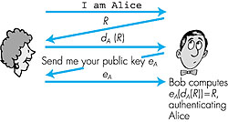

Authentication: ap5.0
Ap5.0: Nonce + Public key cryptography
ap4.0 requires shared symmetric key
problem: how do Bob, Alice agree on key
can we authenticate using public key techniques?
Problem: Trudy may be able to impersonate Alice, and generate her own messages.
Figure 7.12 goes here
d_{T}(R)
e_{T}
*Note: e_{A}(d_{A}(R)) = d_{A}(e_{A}(R)) = R
e_{T}(d_{T}(R))=R
*Note: e_{T}(d_{T}(R)) = d_{T}(e_{T}(R)) = R
Trudy
Eventually, Alice & Bob may find together that someone else was interacting with Bob.

Slide 125
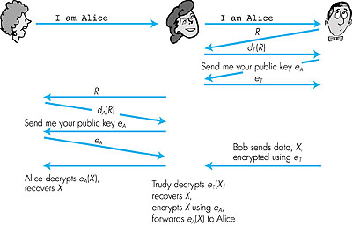
ap5.0: security hole
Man (woman)-in-the-middle attack: Trudy poses as Alice (to Bob) and as Bob (to Alice), and quietly eavesdrop
Alice is happy to receive encrypted message using her own public key
Bob is happy to send encrypted data
Figure 7.14 goes here
Need 'certified' public keys
(more later …)
Alice & Bob may never know that Trudy was there all along.

Slide 126
Man-in-the-middle attack
Examples
an attacker can use a WiFi router as the mechanism with which to intercept user communications.
This can be done either by setting up a malicious router that appears to be legitimate.
an attacker could configure his laptop or other wireless device to act as a WiFi hotspot and give it a name commonly used in a public area such as an airport or coffee shop.
Then, as users connect to the “router” and attempt to reach sensitive sites such as online banking sites or commerce sites, the attacker can capture their credentials for later use.
http://www.techradar.com/news/computing/pc/how-to-turn-your-windows-7-laptop-into-a-wireless-hotspot-657138

Slide 127
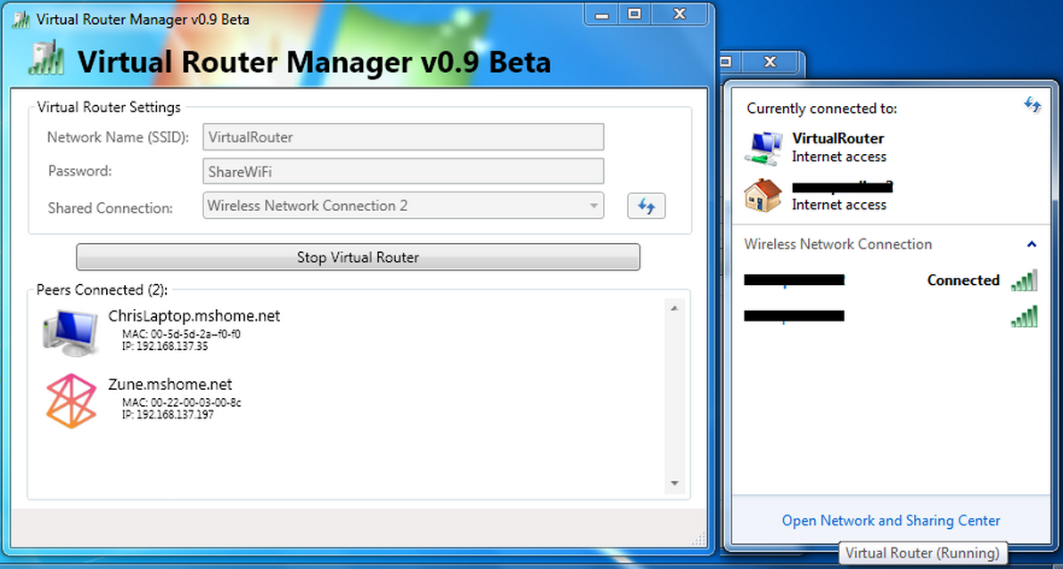
Man-in-the-middle attack
Examples
an attacker uses a WiFi router as the mechanism with which to intercept user communications.
Virtual Router is a free, open source software based router for PCs running Windows 8, Windows 7 or Windows Server 2008 R2. Using Virtual Router, users can wirelessly share any internet connection (Wifi, LAN, Cable Modem, Dial-up, Cellular, etc.) with any Wifi device (Laptop, Smart Phone, iPod Touch, iPhone, Android Phone, Zune, Netbook, wireless printer, etc.) These devices connect to Virtual Router just like any other access point, and the connection is completely secured using WPA2 (the most secure wireless encryption.)

Slide 128
Man-in-the-middle attack
Examples
an attacker uses a WiFi router as the mechanism with which to intercept user communications.
MANUAL SETTING
you can set up a wireless router on yourWindows 7 or 8.1 PC by using the command line.
You need to run an elevated command line to get to the correct page and this is easily done. First off press Windows+R at the same time to reveal the Run box. Here type in 'tskmgr' to open up the Task Manager. Navigate to File, then Run new task. In the text field type in 'cmd' and then check the box next to Create this task with administrative privileges.
When it opens, type in the following command:
netsh wlan set hostednetwork mode=allow ssid=MyNet key=MyPassword
Replace 'MyNet' with a name you want to use for the custom network, and 'MyPassword' with a password that is hard to guess. Press enter to create it and then type in the following text:
netsh wlan start hostednetwork
Press enter again to start it up.

Slide 129
Man-in-the-middle attack
Examples
The man-in-the-middle attack can use ARP spoofing to trick a user into thinking that it is communicating with a legitimate server.
This causes network traffic to flow through the attacker’s system, which enables the attacker to inspect all the data that is sent to and from the victims, including user names, passwords, credit card numbers, and any other information of interest.
Man-in-the-middle attacks can be particularly effective at cafes and libraries that offer their patrons Wi-Fi access to the Internet. In open networking environments such as these, you are directly exposed to computers over unencrypted networks, where your network traffic can be readily snatched.

Slide 130
ARP Spoofing
ARP spoofing is a type of attack in which a malicious actor sends falsified ARP (Address Resolution Protocol) messages over a local area network. This results in the linking of an attacker’s MAC address with the IP address of a legitimate computer or server on the network. Once the attacker’s MAC address is connected to an authentic IP address, the attacker will begin receiving any data that is intended for that IP address.
ARP spoofing can enable malicious parties to intercept, modify or even stop data in-transit. ARP spoofing attacks can only occur on local area networks that utilize the Address Resolution Protocol.

Slide 131
Steps to an ARP spoofing attack
ARP spoofing attacks typically follow a similar progression. The steps to an ARP spoofing attack usually include:
The attacker opens an ARP spoofing tool and sets the tool’s IP address to match the IP subnet of a target. Examples of popular ARP spoofing software include Arpspoof, Cain & Abel, Arpoison and Ettercap.
The attacker uses the ARP spoofing tool to scan for the IP and MAC addresses of hosts in the target’s subnet.
The attacker chooses its target and begins sending ARP packets across the LAN that contain the attacker’s MAC address and the target’s IP address.
As other hosts on the LAN cache the spoofed ARP packets, data that those hosts send to the victim will go to the attacker instead. From here, the attacker can steal data or launch a more sophisticated follow-up attack.
Note: ARP does not provide authentication.
http://www.veracode.com/security/arp-spoofing

Slide 132
ARP Spoofing Detection, Prevention and Protection
Packet filtering: Packet filters inspect packets as they are transmitted across a network. Packet filters are useful in ARP spoofing prevention because they are capable of filtering out and blocking packets with conflicting source address information (packets from outside the network that show source addresses from inside the network and vice-versa).
Avoid trust relationships: Organizations should develop protocols that rely on trust relationships as little as possible. Trust relationships rely only on IP addresses for authentication, making it significantly easier for attackers to run ARP spoofing attacks when they are in place.
Use ARP spoofing detection software: There are many programs available that help organizations detect ARP spoofing attacks. These programs work by inspecting and certifying data before it is transmitted and blocking data that appears to be spoofed.
Use cryptographic network protocols: Transport Layer Security (TLS), Secure Shell (SSH), HTTP Secure (HTTPS) and other secure communications protocols bolster ARP spoofing attack prevention by encrypting data prior to transmission and authenticating data when it is received.

Slide 133
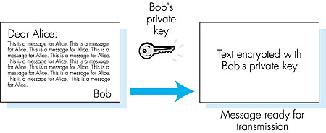
Digital Signatures
Using public-key cryptography
Cryptographic technique analogous to hand-written signatures.
Sender (Bob) digitally signs document, establishing he is document owner/creator.
Verifiable,
non-forgeable,
non-repudiable
recipient (Alice) can verify that Bob, and no one else, signed document.
Simple digital signature for message m:
Bob encrypts m with his private key d_{B}, creating signed message, d_{B}(m).
Bob sends m and d_{B}(m) to Alice.

Slide 134
Digital Signatures (more)
Suppose Alice receives msg m, and digital signature d_{B}(m)
Alice verifies m signed by Bob by applying Bob’s public key e_{B} to d_{B}(m) then checks e_{B}(d_{B}(m) ) = m.
If e_{B}(d_{B}(m) ) = m, whoever signed m must have used Bob's private key.
Alice thus verifies that:
Bob signed m.
No one else signed m.
Bob signed m and not m’.
Non-repudiation:
Alice can take m, and signature d_{B}(m) to court and prove that Bob signed m.

Slide 135
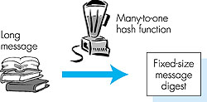
Message Digests
It is computationally expensive to public-key-encrypt long messages.
apply hash function H to m, get fixed size message digest, H(m).
Goal: fixed-length 'fingerprint‘
easy to compute digital signature using the message digest
Hash function properties:
Many-to-1
Produces fixed-size msg digest (fingerprint)
NON-FORGEABILITY REQUIREMENT
Given message digest x, computationally infeasible to find m such that x = H(m)
computationally infeasible to find any two messages m and m' such that
H(m) = H(m').

Slide 136
Internet checksum: poor crypto hash function
Internet checksum has some properties of hash function:
produces fixed length digest (16-bit sum) of message
is many-to-one
But given message with given hash value, it is easy to find another message with the same hash value:
message
ASCII format
message
ASCII format
I O U 1
0 0 . 9
9 B O B
49 4F 55 31
30 30 2E 39
39 42 D2 42
I O U 9
0 0 . 1
9 B O B
49 4F 55 39
30 30 2E 31
39 42 D2 42
B2 C1 D2 AC
different messages
but identical checksums!
B2 C1 D2 AC

Slide 137
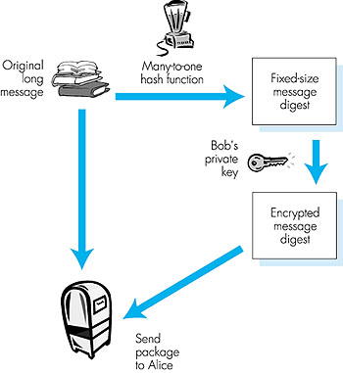
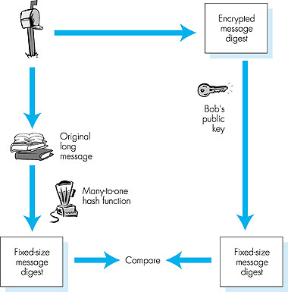
Digital signature = Signed message digest
Bob sends digitally signed message:
Alice verifies signature and integrity of digitally signed message:

Slide 138
Hash Function Algorithms
Internet checksum would make a poor message digest.
Too easy to find two messages with same checksum.
Even using a 128-bit CRC it would be easy to find a second message to fit to the CRC
MD5 hash function widely used (RFC1321 with C-code).
Computes 128-bit message digest in 4-step process.
For any arbitrary 128-bit message digest x, it appears difficult (2¹²⁸ operations) to construct msg m whose MD5 hash is equal to x.
SHA-1 is also used.
US federal standard
160-bit message digest
Secure Hash Algorithm
Notes:
Secure hash algorithm

Slide 139
Network Security
Trusted Intermediaries
Notes:
TCP
PIPE-LINED PROTOCOL
SEQUENCE NUMBER - Uses byte-stream order of data
CUMULATIVE ACK
1 TIMER CONTROL – associated with the oldest unACKed segment
Dynamically estimates the Timeout interval using an Exponential Weighted Moving Average technique
Buffers out-of-order segments
Employs a flow control mechanism
Employs a congestion control mechanism
Tries to allocate bandwidth fairly among users of TCP.

Slide 140
Trusted Intermediaries
Problem:
How do two entities establish shared secret key over network?
Solution:
trusted key distribution centre (KDC) acting as intermediary between entities
Problem:
When Alice obtains Bob's public key (from web site, e-mail), how does she know it is Bob's public key, not Trudy's?
Solution:
trusted certification authority (CA)

Slide 141
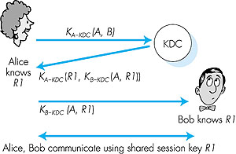
Key Distribution Center (KDC)
How can Alice & Bob get a shared symmetric key in a secured way?
It’s Alice, I want to talk to Bob securely
Includes an expiration time
Alice,Bob need shared symmetric key.
KDC: server shares different secret key with each registered user.
Alice, Bob are registered users of KDC, they know their own symmetric keys, K_{A-KDC} , K_{B-KDC} , for communicating with KDC.
(A, R1, etime))
(A, R1, nonce))
Alice communicates with KDC, gets session key R1, and K_{B-KDC}(A,R1)
Alice sends Bob K_{B-KDC}(A,R1), Bob extracts R1
Alice, Bob now share the symmetric key R1.
Includes an R1-encrypted time-stamp (nonce) – Bob needs to use this in his reply to show that he is “live”
KDC uses the appropriate private user secret key to communicate with them.

Slide 142
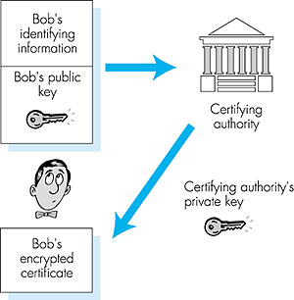
Certification Authorities
Certification authority (CA) binds public key to particular entity.
Entity (person, router, etc.) can register its public key with CA.
Entity provides proof of identity to CA.
CA creates certificate binding entity to public key.
Certificate digitally signed by CA.
When Alice wants Bob's public key:
gets Bob's certificate (from Bob or elsewhere).
Apply CA's public key to Bob's certificate, get Bob's public key

Slide 143
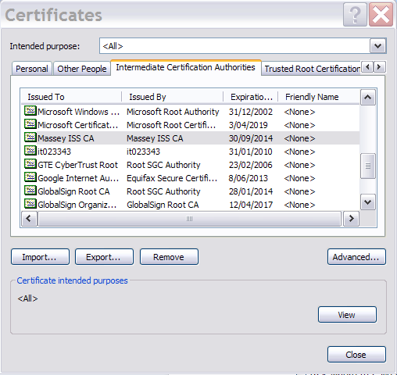
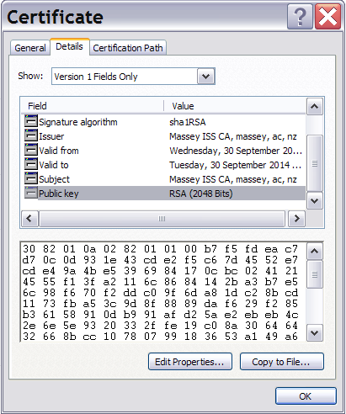
Certificate Sample
International Telecommunication Union (ITU) & IETF: set standards for CAs
For more info: https://sites.google.com/site/ddmwsst/digital-certificates

Slide 144



Certification Authorities
International Telecommunication Union (ITU) & IETF: set standards for CAs
Take a look at the CA in the browser...
For more info: https://sites.google.com/site/ddmwsst/digital-certificates

Slide 145
Network Security
Secure e-mail

Slide 146
Secure e-mail
Desirable Security Features
Confidentiality
Sender authentication
“I don’t love you anymore. I never want to see you again. Formerly yours, Alice”
Message Integrity
Receiver Authentication
Tools:
symmetric key & public key cryptography
Authentication
Key Distribution
Message Integrity
Digital Signatures
Next
Let’s see a step-wise evolution of a design of a Secure E-mail

Slide 147

Secure e-mail
SE v1
Confidentiality
Alice wants to send secret e-mail message, m, to Bob.
generates random symmetric private key, K_{S}.
encrypts message with K_{S}
also encrypts K_{S} with Bob's public key.
sends both K_{S}(m) and e_{B}(K_{S}) to Bob.
Tools: Symmetric Session key + Public key cryptography
Notes:
Here, Bob can never know for sure if the message came from Alice.
How can Alice be sure that she is using Bob’s public key, and not somebody else’s? Bob should provide his CA-signed public key.

Slide 148

Secure e-mail (continued)
SE v2
X
Confidentiality + Authentication + Message Integrity
Alice wants to provide sender authentication and message integrity.
Alice digitally signs message.
sends both message (in the clear) and digital signature.
Tools: Hash Function + Digital Signature
Notes:
d_{a} – private key of Alice
e_{a} – public key of Alice

Slide 149

Secure e-mail (continued)
SE v3
Confidentiality + Authentication + Message Integrity
Alice wants to provide secrecy, sender authentication, message integrity.
Confidentiality measures
Authentication +
Message Integrity
Note: Alice uses both her private key, Bob's public key and a symmetric key.
Notes:
Alice and Bob should acquire each other’s public key through a CA-signed certificate.
Confidentiality – symmetric key
Integrity – message digest
Authentication – signed message digest (public key cryptography – using private key by the sender)

Slide 150


Pretty good privacy (PGP)
d_{A}(H(m))
Internet e-mail encryption scheme, a de-facto standard.
Uses symmetric key cryptography, public key cryptography, hash function, and digital signature as described.
Provides secrecy, sender authentication, integrity.
Inventor, Phil Zimmerman, was target of 3-year federal investigation.
Sample PGP signed message
Sample Secret PGP message
Cryptography programs are considered munitions under US federal law and are not allowed to be exported

Slide 151
PGP
TOOLS
Design
Similar to SEv3 diagram discussed
Creation of Message Digest
MD5, SHA
Symmetric Key Encyption
CAST, triple-DES, IDEA
Public Key Encyption
RSA
Compression

Slide 152
Pretty good privacy (PGP)
Freely available on http://web.mit.edu/network/pgp.html
Look also www.pgp.com
Zimmermann has received technical awards
2001: he was inducted into the CRN Industry Hall of Fame
2000: InfoWorld named him one of the Top 10 Innovators in E-Business
1999: Louis Brandeis Award from Privacy International
1998: Lifetime Achievement Award from Secure Computing Magazine
1996: the Norbert Wiener Award from Computer Professionals for promoting the responsible use of technology.
1997: Founded PGP, Inc., which was acquired by Network Associates.

Slide 153
Network Security
Securing TCP Connections

Slide 154
SSL: Secure Sockets Layer
widely deployed security protocol
supported by almost all browsers, web servers
https
billions $/year over SSL
mechanisms: [Woo 1994], implementation: Netscape
variation -TLS: transport layer security, RFC 2246
provides
confidentiality
integrity
authentication
original goals:
Web e-commerce transactions
encryption (especially credit-card numbers)
Web-server authentication
optional client authentication
minimum hassle in doing business with new merchant
available to all TCP applications
secure socket interface

Slide 155
SSL and TCP/IP
Application
Application
Application
Layer
SSL
TCP
TCP
IP
IP
normal application
application with SSL
SSL provides an application programming interface (API) to applications
C and Java SSL libraries/classes readily available

Slide 156
a simple secure channel
handshake: Alice and Bob use their certificates, private keys to authenticate each other and exchange shared secret
key derivation: Alice and Bob use shared secret to derive set of keys
data transfer: data to be transferred is broken up into series of records
connection closure: special messages to securely close connection

Slide 157


Highly-simplified handshake
hello
public key certificate
K_{A}⁺(MS) = EMS
MS: master secret
EMS: encrypted master secret

Slide 158
SSL cipher suite
SSL supports several cipher suites
public-key algorithm
symmetric encryption algorithm
MAC algorithm
Negotiation phase:
client indicates available cryptographic algorithms
server picks suitable ones
Common Symmetric Ciphers:
DES – Data Encryption Standard: block
3DES – Triple strength: block
RC2 – Rivest Cipher 2: block
RC4 – Rivest Cipher 4: stream
Public key encryption:
RSA

Slide 159
key derivation
considered bad to use same key for more than one cryptographic operation
use different keys for message authentication code (MAC) and encryption
four keys:
e_{B} = encryption key for data sent from client (Bob) to server (Alice)
M_{B} = MAC key for data sent from client (Bob) to server (Alice)
e_{A} = encryption key for data sent from server(Alice) to client (Bob)
M_{A} = MAC key for data sent from server(Alice) to client (Bob)
keys derived from standard SSL key derivation function
takes master secret and nonces and creates the keys

Slide 160
SSL record format
1 byte
2 bytes
3 bytes
content
type
length
SSL version
data
Handshake
Application data
closure
MAC
data and MAC encrypted (symmetric algorithm)

Slide 161
SSL record protocol
data
data
fragment
MAC
data
fragment
MAC
record
header
encrypted
data and MAC
record
header
encrypted
data and MAC
record header: content type; version; length
MAC: includes sequence number, MAC key M_{x}
fragment: each SSL fragment 2¹⁴ bytes (~16 Kbytes)

Slide 162
Real SSL: handshake (1)
Purpose
server authentication
negotiation: agree on crypto algorithms
establish keys
client authentication (optional)

Slide 163
Simplified SSL connection
Nonce_{B}, list of supported cryp. algorithms.
Nonce_{A},AES,RSA_1024,SHA-1, certificate
d_{CA}(e_{A’})
e_{CA}(d_{CA}(e_{A’}))=e_{A’}
d_{A’} (e_{A’}(PMS)) =PMS
Generate Pre-Master Secret(PMS)
e_{A’} (PMS)
Using SSL standard derivation function(PMS, nonces), generate Master Secret (MS)
Split MS to generate the following session keys:
E_{A}
M_{A}
E_{B}
M_{B}
IV_{A}
IV_{A}
Using SSL standard derivation function(PMS, nonces), generate Master Secret (MS)
Split MS to generate the following session keys:
E_{A}
M_{A}
E_{B}
M_{B}
IV_{A}
IV_{A}
Send MAC of all handshake msgs
everything henceforth
is encrypted and authenticated
Send MAC of all handshake msgs

Slide 164
Real SSL: handshake (2)
client sends list of algorithms it supports, along with client nonce
server chooses algorithms from list; sends back: choice + certificate + server nonce
client verifies certificate, extracts server’s public key, generates pre_master_secret, encrypts with server’s public key, sends to server
client and server independently compute encryption and MAC keys from pre_master_secret and nonces
client sends a MAC of all the handshake messages
server sends a MAC of all the handshake messages

Slide 165
Simplified SSL connection
Nonce_{B}, list of supported cryp. algorithms.
CLEAR TEXT
Nonce_{A},AES,RSA_1024,SHA-1, certificate
CLEAR TEXT
d_{CA}(e_{A’})
e_{A’} (PMS)
Send MAC of all handshake msgs
everything henceforth
is encrypted and authenticated
Send MAC of all handshake msgs
To allow Alice and Bob to verify the integrity of all messages sent and received in cleartext. If found to be altered, disconnect.

Slide 166
Real SSL: handshaking (3)
last 2 steps protect handshake from tampering
client typically offers range of algorithms, some strong, some weak
man-in-the middle could delete stronger algorithms from list
last 2 steps prevent this
last two messages are encrypted

Slide 167
Real SSL: handshaking (4)
why two random nonces?
suppose Trudy sniffs all messages between Alice & Bob
next day, Trudy sets up TCP connection with Alice, sends exact same sequence of records
Alice(Amazon) thinks Bob made two separate orders for the same thing
solution: Alice sends different random nonce for each connection. This causes encryption keys to be different on the two days
Trudy’s messages will fail Alice’s integrity check

Slide 168

SSL connection closure
Nonce_{B}, list of supported cryp. algorithms.
CLEAR TEXT
Nonce_{A},AES,RSA_1024,SHA-1, certificate
CLEAR TEXT
d_{CA}(e_{A’})
TCP FIN
What happens if Trudy attempts to send a fake TCP FIN to Alice, to break the connection prematurely?
Alice expects that an SSL closure record would come first, before a TCP FIN segment would be received
Therefore, she would detect something fishy is going on

Slide 169
Key derivation
client nonce, server nonce, and pre-master secret (PMS) input into pseudo random-number generator.
produces master secret (MS)
(MS)master secret and new nonces input into another random-number generator: “key block”
key block sliced and diced:
client MAC key
server MAC key
client encryption key
server encryption key
client initialization vector (IV)
server initialization vector (IV)

Slide 170
Network Security
Securing Network-layer (Blanket coverage)

Slide 171
What is network-layer confidentiality ?
between two network entities:
sending entity encrypts datagram payload, payload could be:
TCP or UDP segment, ICMP message, OSPF message ….
all data sent from one entity to other would be hidden:
web pages, e-mail, P2P file transfers, TCP SYN packets …
“blanket coverage”

Slide 172
Virtual Private Networks (VPNs)
motivation:
institutions often want private networks for security.
costly: separate routers, links, DNS infrastructure.
VPN: institution’s inter-office traffic is sent over public Internet instead
encrypted before entering public Internet
logically separate from other traffic

Slide 173



Virtual Private Networks (VPNs)
public Internet
laptop
w/ IPsec
IP
header
IPsec
header
Secure
payload
salesperson in hotel
IP
header
IPsec
header
Secure
payload
IP
header
IPsec
header
Secure
payload
router w/
IPv4 and IPsec
router w/
IPv4 and IPsec
IP
header
payload
IP
header
payload
branch office
headquarters

Slide 174
IPsec services
data integrity
origin authentication
replay attack prevention
confidentiality
two protocols providing different service models:
AH
ESP (Encapsulation Security Protocol)

Slide 175
IPsec transport mode
IPsec
IPsec
IPsec datagram emitted and received by end-system
protects upper level protocols

Slide 176
IPsec – tunneling mode
IPsec
IPsec
IPsec
IPsec
edge routers IPsec-aware
hosts IPsec-aware

Slide 177
Two IPsec protocols
Authentication Header (AH) protocol
provides source authentication & data integrity but not confidentiality
Encapsulation Security Protocol (ESP)
provides source authentication, data integrity, and confidentiality
more widely used than AH

Slide 178
Four combinations are possible!
Host mode with AH | Host mode with ESP
Tunnel mode with AH | Tunnel mode with ESP
most common and most important

Slide 179
Security associations (SAs)
before sending data, “security association (SA)” established from sending to receiving entity
SAs are simplex: for only one direction
ending, receiving entitles maintain state information about SA
recall: TCP endpoints also maintain state info
IP is connectionless; IPsec is connection-oriented!
how many SAs in VPN w/ headquarters, branch office, and n traveling salespeople?

Slide 180
Example SA from R1 to R2
headquarters
Internet
branch office
200.168.1.100
193.68.2.23
R1
security association
R2
172.16.1/24
172.16.2/24
R1 stores for SA:
32-bit SA identifier: Security Parameter Index (SPI)
origin SA interface (200.168.1.100)
destination SA interface (193.68.2.23)
type of encryption used (e.g., 3DES with CBC)
encryption key
type of integrity check used (e.g., HMAC with MD5)
authentication key

Slide 181
Security Association Database (SAD)
endpoint holds SA state in security association database (SAD), where it can locate them during processing.
with n salespersons, 2 + 2n SAs in R1’s SAD
when sending IPsec datagram, R1 accesses SAD to determine how to process datagram.
when IPsec datagram arrives to R2, R2 examines SPI in IPsec datagram, indexes SAD with SPI, and processes datagram accordingly.

Slide 182
IPsec datagram
Tunnel mode with ESP(Encapsulation Security Protocol)
“enchilada” authenticated
encrypted
new IP header
ESP
hdr
original IP hdr
Original IP
datagram payload
ESP
trl
ESP
auth
SPI
Seq
#
padding
pad length
next header
UDP, TCP, etc.

Slide 183
What happens?
headquarters
Internet
branch office
200.168.1.100
193.68.2.23
R1
security association
R2
172.16.1/24
172.16.2/24
“enchilada” authenticated
encrypted
new IP header
ESP
hdr
original IP hdr
Original IP
datagram payload
ESP
trl
ESP
auth
SPI
Seq
#
padding
pad length
next header

Slide 184
R1: convert original datagram to IPsec datagram
appends to back of original datagram (which includes original header fields!) an “ESP trailer” field.
encrypts result using algorithm & key specified by SA.
appends to front of this encrypted quantity the “ESP header, creating “enchilada”.
creates authentication MAC over the whole enchilada, using algorithm and key specified in SA;
appends MAC to back of enchilada, forming payload;
creates brand new IP header, with all the classic IPv4 header fields, which it appends before payload.

Slide 185
Inside the enchilada:
“enchilada” authenticated
encrypted
new IP header
ESP
hdr
original IP hdr
Original IP
datagram payload
ESP
trl
ESP
auth
SPI
Seq
#
padding
pad length
next header
ESP trailer: Padding for block ciphers
ESP header:
SPI, so receiving entity knows what to do
Sequence number, to thwart replay attacks
MAC in ESP auth field is created with shared secret key

Slide 186
IPsec
https://wiki.wireshark.org/SSL
How to set-up servers/clients:
http://www.it.cornell.edu/services/managed_servers/howto/ipsec.cfm

Slide 187
Internet security threats
Sniffer – tool for capturing packets sent across wire/air
Packet sniffing:
broadcast media (remember CSMA/CD protocol)
promiscuous NIC reads all packets passing by
can read all unencrypted data (e.g. passwords)
our best defense: cryptography
e.g.: C sniffs B's packets
A
C
src:B dest:A payload
B
e.g. TCPDump, Snoop, Snort, Wireshark
Notes:
tcpdump, a powerful command-line packet analyzer; and libpcap, a portable C/C++ library for network traffic capture.
snoop is a very flexible command line packet analyzer included as part of Sun Microsystems' Solaris operating system. Its source code is available via the OpenSolaris project.

Slide 188

Wireshark, Ethereal
An adapter could be set to listen in promiscuous mode.
Let’s see a sample capture file from Wireshark
Notes:
Promiscuous - unselective

Slide 189

WinPcap is the industry-standard windows packet capture library.
it allows applications to capture and transmit network packets bypassing the protocol stack, and has additional useful features, including:
kernel-level packet filtering
a network statistics engine and
support for remote packet capture.
Used by protocol analysers, network monitors, network intrusion detection systems, sniffers, traffic generators and network testers
https://www.winpcap.org/

Slide 190
Internet security threats
Spoofing: providing false information about your identity in order to gain unauthorized access to systems
IP Spoofing:
can generate raw IP packets directly from application, putting false IP source address
receiver can't tell if source is spoofed
End-point authentication is needed to solve this problem
e.g.: Host C pretends to be Host B
A
C
attacker
src:B dest:A payload
B
Notes:
Some interesting codes:
http://www.tenouk.com/download/pdf/Module43.pdf

Slide 191
Internet security threats
Attack: to reduce ability to service clients by overloading target
Denial of service (DOS):
flood of maliciously generated packets swamp receiver (web server, DNS server, email server, institutional network, etc.)
Distributed DOS (DDOS): multiple coordinated sources swamp receiver
e.g., C and remote host SYN-attack Host A
Target server
A
C
SYN
SYN
SYN
SYN
SYN
B
SYN
SYN

Slide 192

DoS
Exploits basic weakness of TCP/IP Protocol
Recall
Attacker sends thousands and thousands of SYN packets to the victim
Victim is forced to wait for replies that would never come.
While the host is waiting for so many replies, it cannot accept any legitimate requests, so it becomes unavailable
In addition, the access link of the target may get clogged as well, making it unreachable

Slide 193
Network Security
Network Layer-Related Topics
We shall cover this when we discuss the Network Layer

Slide 194
Firewall
Uses a combination of hardware and software components
isolates organization's internal net from larger Internet, allowing some packets to pass, blocking others.
gateway-to-remote
host telnet session
X
application
gateway
router and filter

Slide 195
Firewall
To prevent denial of service attacks:
SYN flooding: attacker establishes many bogus TCP connections. Consequence of Attacks: host allocates TCP buffers for bogus connections, none left for real connections.
To prevent illegal modification of internal data.
e.g., attacker replaces CIA's homepage with something else
To prevent intruders from obtaining secret info.
Three firewall types:
packet filter
(network layer)
stateful filters (network layer)
application gateways (application layer)

Slide 196
Firewall
Packet Filter
Examine each datagram in isolation, apply administrator-specific rules to determine whether a packet should pass or be dropped.
Notes:
TCP
PIPE-LINED PROTOCOL
SEQUENCE NUMBER - Uses byte-stream order of data
CUMULATIVE ACK
1 TIMER CONTROL – associated with the oldest unACKed segment
Dynamically estimates the Timeout interval using an Exponential Weighted Moving Average technique
Buffers out-of-order segments
Employs a flow control mechanism
Employs a congestion control mechanism
Tries to allocate bandwidth fairly among users of TCP.

Slide 197
PACKET FILTERING
Operates at the Network Layer
The Internet access relies on a particular Router
The router can filter packets based on:
IP addresses
Domain names
TCP or UDP source and destination Port numbers
Protocol types (e.g. ICMP message type)
Connection-initialisation TCP SYN and ACK bits on a TCP packet
router interfaces (Different rules for each interface)
Coarse-grain filtering on IP and TCP/UDP headers
Operates by sequentially checking filtering rules against the datagram being inspected
the first rule matching the datagram determines the action taken

Slide 198
PACKET FILTERING
Example 1: Prevent external clients from making TCP connections with internal servers, but allow internal clients to connect to external servers.
Block inbound TCP segments with ACK = 0
Example 2: prevent web-radios from eating up the available bandwidth
Drop all incoming UDP packets, except DNS packets (port=53)
Example 3: block 'ping'
In order to avoid external users to find suitable IP addresses to attack. (ICMP Type=8, Code=0)
Example 4:
Block domain names that are known to be dangerous to users or inadequate for the scope of the institution.
Example 5: Prevent your network from being tracerouted.
Drop all outgoing ICMP TTL expired traffic.

Slide 199
PACKET FILTERING
EXAMPLE
Alice administers a company network 222.22.0.0/16 and, in general, wants to disallow access to her network from the public internet (R3). However, Alice collaborates with Bob and his colleagues who are at network 111.11/16. Alice wants to let users from Bob’s network access a specific subnet, 222.22.22/24 within her company’s network (R1). The problem is that Trudy belongs to Bob’s network, with subnet 111.11.11/24. Therefore, Alice doesn’t want any traffic from 111.11.11/24 entering anywhere into her network (R2).
Packet filtering rules (ordering of evaluation is important!)
 | SOURCE IP | DEST IP | Desired Action | Comments
R1 | 111.11/16 | 222.22.22/24 | Permit | Let datagram from Bob’s university into a restricted subnet.
R2 | 111.11.11/24 | 222.22/16 | Deny | Don’t let traffic from Trudy’s subnet into anywhere within Alice’s network
R3 | 0.0.0.0/0 | 0.0.0.0/0 | Deny | Don’t let traffic into Alice’s network

Slide 200
PACKET FILTERING
EXAMPLE
Specifying filtering rules
 | SOURCE IP | DEST IP | Desired Action | Comments
R1 | 111.11/16 | 222.22.22/24 | Permit | Let datagram from Bob’s university into a restricted subnet.
R2 | 111.11.11/24 | 222.22/16 | Deny | Don’t let traffic from Trudy’s subnet into anywhere within Alice’s network
R3 | 0.0.0.0/0 | 0.0.0.0/0 | Deny | Don’t let traffic into Alice’s network
 | SOURCE IP | DEST IP | Desired Action | R2,R1,R3 | R1,R2,R3
P1 | 111.11.11.1 | 222.22.6.6 | Deny | Deny(R2) | Deny(R2)
P2 | 111.11.11.1 | 222.22.22.2 | Deny | Deny(R2) | Permit(R1)
P3 | 111.11.6.6 | 222.22.22.2 | Permit | Permit(R1) | Permit(R1)
P4 | 111.11.6.6 | 222.22.6.6 | Deny | Deny(R3) | Deny(R3)

Slide 201
PACKET FILTERING
EXAMPLE
Operates at the Network Layer
 | SOURCE IP | DEST IP | Desired Action | R2,R1,R3 | R1,R2,R3
P1 | 111.11.11.1 | 222.22.6.6 | Deny | Deny(R2) | Deny(R2)
P2 | 111.11.11.1 | 222.22.22.2 | Deny | Deny(R2) | Permit(R1)
P3 | 111.11.6.6 | 222.22.22.2 | Permit | Permit(R1) | Permit(R1)
P4 | 111.11.6.6 | 222.22.6.6 | Deny | Deny(R3) | Deny(R3)
Applying more specific rules first does not always avoid unanticipated or unwanted behaviour arising from ordering issues

Slide 202
Firewall
Stateful Packet Filters
Track connections, make decisions using knowledge of connections
Notes:
TCP
PIPE-LINED PROTOCOL
SEQUENCE NUMBER - Uses byte-stream order of data
CUMULATIVE ACK
1 TIMER CONTROL – associated with the oldest unACKed segment
Dynamically estimates the Timeout interval using an Exponential Weighted Moving Average technique
Buffers out-of-order segments
Employs a flow control mechanism
Employs a congestion control mechanism
Tries to allocate bandwidth fairly among users of TCP.

Slide 203
Access Control List for a Stateful Filter
EXAMPLE
Firewall rules are implemented in routers with access control lists, with each router interface having its own list.
action | Source IP | Dest IP | Protocol | Source Port | Dest Port | Flag bit | Check connection
allow | 222.22/16 | Outside of 222.22/16 | TCP | >1023 | 80 | any
allow | Outside of 222.22/16 | 222.22/16 | TCP | 80 | >1023 | ACK | X
allow | 222.22/16 | Outside of 222.22/16 | UDP | >1023 | 53 | _
allow | Outside of 222.22/16 |  | UDP | 53 | >1023 | _ | X
deny | all | all | all | all | all | all
Web surfing
DNS packets

Slide 204
Connection Table for a Stateful Filter
EXAMPLE
Source IP | Dest IP | Source Port | Dest Port
222.22.1.7 | 37.96.87.123 | 12699 | 80
222.22.93.2 | 199.205.23 | 37654 | 80
222.22.65.143 | 203.77.240.43 | 48712 | 80

Slide 205
Access Control List for a Stateful Filter
EXAMPLE
action | Source IP | Dest IP | Protocol | Source Port | Dest Port | Flag bit | Check connection
allow | 222.22/16 | Outside of 222.22/16 | TCP | >1023 | 80 | any
allow | Outside of 222.22/16 | 222.22/16 | TCP | 80 | >1023 | ACK | X
allow | 222.22/16 | Outside of 222.22/16 | UDP | >1023 | 53 | _
allow | Outside of 222.22/16 |  | UDP | 53 | >1023 | _ | X
deny | all | all | all | all | all | all
Attacker sends a
malformed packet:
TCP source port 80,
ACK flag set,
dest port 12543,
source IP: 150.23.23.155
Connection Table for a Stateful Filter
Source IP | Dest IP | Source Port | Dest Port
222.22.1.7 | 37.96.87.123 | 12699 | 80
222.22.93.2 | 199.205.23 | 37654 | 80
222.22.65.143 | 203.77.240.43 | 48712 | 80

Slide 206
Access Control List for a Stateful Filter
EXAMPLE
action | Source IP | Dest IP | Protocol | Source Port | Dest Port | Flag bit | Check connection
allow | 222.22/16 | Outside of 222.22/16 | TCP | >1023 | 80 | any
allow | Outside of 222.22/16 | 222.22/16 | TCP | 80 | >1023 | ACK | X
allow | 222.22/16 | Outside of 222.22/16 | UDP | >1023 | 53 | _
allow | Outside of 222.22/16 |  | UDP | 53 | >1023 | _ | X
deny | all | all | all | all | all | all
Attacker sends a
malformed packet:
TCP source port 80,
ACK flag set,
dest port 12543,
source IP: 150.23.23.155
When the packet reaches the firewall, the firewall consults the access control list, which indicates that the connection table must be checked as well. Eventually, it learns that the packet is not part of an on-going connection, and is therefore rejected.
Source IP | Dest IP | Source Port | Dest Port
222.22.1.7 | 37.96.87.123 | 12699 | 80
222.22.93.2 | 199.205.23 | 37654 | 80
222.22.65.143 | 203.77.240.43 | 48712 | 80

Slide 207
Firewall
Application Gateway
How to provide services to a restricted set of internal users?
Requires application-layer data
not available in IP/TCP/UDP headers anymore
Notes:
TCP
PIPE-LINED PROTOCOL
SEQUENCE NUMBER - Uses byte-stream order of data
CUMULATIVE ACK
1 TIMER CONTROL – associated with the oldest unACKed segment
Dynamically estimates the Timeout interval using an Exponential Weighted Moving Average technique
Buffers out-of-order segments
Employs a flow control mechanism
Employs a congestion control mechanism
Tries to allocate bandwidth fairly among users of TCP.

Slide 208
APPLICATION GATEWAYS
Application-specific server through which all application data must pass
gateway-to-remote
host telnet session
host-to-gateway
telnet session
Packet Filter + Application Gateway
application
gateway
router and filter
e.g. Force all outbound Telnet connections to pass through the application gateway
Make policy decisions based on application data
Each Gateway = separate server with own processes
Multiple application gateways on the same host
e.g. Telnet, HTTP, FTP,
mail server, Web Cache
Notes:
Telnet protocol: Port=23 TCP,UDP, unencrypted text communications

Slide 209
APPLICATION GATEWAYS
gateway-to-remote
host telnet session
host-to-gateway
telnet session
Filters packets on application data as well as on IP/TCP/UDP fields.
Example: Allow only selected internal users to telnet outside.
application
gateway
router and filter
1. Require all telnet users to telnet through gateway.
2. For authorized users, gateway sets up telnet connection to dest host. Gateway relays data between 2 connections
3. Router filter blocks all telnet connections not originating from gateway.

Slide 210
Limitations of firewalls and gateways
IP spoofing: router can't know if data really comes from claimed source
Multiple applications need special treatment; each with its own gateway.
Client software must know how to contact gateway.
e.g., must set IP address of proxy in Web browser
Filters often use all or nothing policy for UDP.
Trade off: degree of communication with outside world, level of security
Many highly protected sites still suffer from attacks.
Does not protect against the enemy from within.

Slide 211

Snort®
Snort® is an open source network intrusion prevention and detection system (IDS/IPS) developed by Sourcefire. Combining the benefits of signature, protocol, and anomaly-based inspection, Snort is the most widely deployed IDS/IPS technology worldwide. With millions of downloads and nearly 400,000 registered users, Snort has become the de facto standard for IPS.

Slide 212
Others
secure socket windows
C++:
https://msdn.microsoft.com/en-us/library/windows/desktop/bb394814(v=vs.85).aspx
https://msdn.microsoft.com/en-us/library/windows/desktop/bb394815(v=vs.85).aspx
http://www.reuters.com/article/us-usa-security-nsa-rsa-idUSBREA2U0TY20140331

Slide 213
END OF SESSION

